Slide 1
EXSCEL Primary Results Presentation
EASD
Lisbon, Portugal
Thursday 14th September, 2017

Slide 2
Study Rationale, Design and Conduct
Robert J. Mentz, MD
Duke Clinical Research Institute

Slide 3
Presenter Disclosure Information
Research support:
  AstraZeneca, Amgen, GlaxoSmithKline
Advisory boards:
Amgen, Boehringer-Ingelheim

Slide 4

Burden of Diabetes
>420 million people in the world have diabetes
Prevalence of 8.5% and increasing among the adult population
World Health Organisation 2016

Slide 5
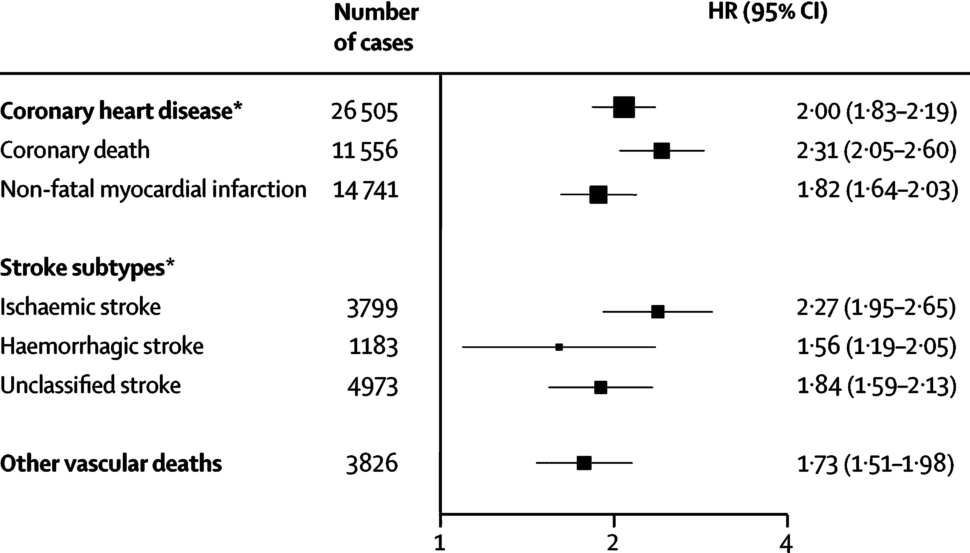
Diabetes-related Complications
Diabetes is an important cause of blindness, kidney failure, and amputation events that impact quality of life
Diabetes increases CV events; causes >1.5 million deaths annually
Vascular Outcomes with Diabetes (reference: no Diabetes)
Adjusted for age, smoking, BMI and SBP
World Health Organisation 2016; Sarwar N. Lancet 2010.

Slide 6
Evaluating Cardiovascular Risk in New Antidiabetic Therapies
Regulatory requirement that new therapies to treat T2DM both effectively lower glucose levels and demonstrate evidence of cardiovascular safety
Large cardiovascular outcomes trials required for novel T2DM therapies with robust assessment of cardiovascular end-points and important safety events

Slide 7
EXSCEL
Large, pragmatic, international trial designed to characterise the effects of once weekly GLP-1 receptor agonist, exenatide, on CV-related outcomes in patients with T2DM, when added to usual diabetes care
Double-blind, placebo-controlled trial randomising participants to exenatide 2 mg once weekly injection or matching placebo
Academically led by the Diabetes Trials Unit, University of Oxford and the Duke Clinical Research Institute in collaboration with industry sponsorship

Slide 8
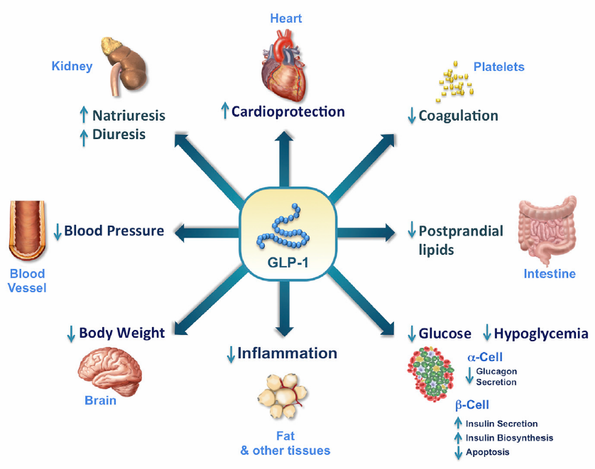
Direct and Indirect Effects of GLP-1
Drucker DJ. Cell Metabolism 2016

Slide 9
Pragmatic Study Design
Integration with usual care
  Management of diabetes, CV risk factors and pre-existing CV disease remained responsibility of usual care provider based on local practice patterns and guidelines
  Concomitant DM therapy at discretion of usual providers
    Concomitant open-label GLP-1RA prohibited
Streamlined trial conduction
  Broad inclusion/exclusion criteria representative of patient population
    Wide range of CV risk; no enrichment for elderly individuals
    DPP-4 inhibitors permitted
  No run-in period
  Visits every 6 months to minimise interference with usual care
  All efficacy and safety (except for annual calcitonin) laboratory results collected as available from the usual care setting

Slide 10
EXSCEL: Study Design
EXENATIDE ONCE WEEKLY
~14,000 Patients
Safety Follow-up
(70-days)
PLACEBO ONCE WEEKLY
Randomisation
(double blind)
1w 2m 6m 1y
Six monthly visits
End of Treatment
Minimum 1360 primary events
Aim is for glycaemic equipoise, but not a requirement
Key Inclusion Criteria
T2DM, HbA1c 6.5-10% (inclusive)
Anti-DM drug naïve, oral agents and/or insulin
≥18 years old
Any level of CV risk
~70% with prior CV event
  Prior coronary, cerebrovascular or peripheral vascular event or stenosis
Key Exclusion Criteria
T1DM
≥2 episodes of severe hypoglycaemia within 12 months
Current or prior GLP1-RA
eGFR <30mL/min/1.73m²
Prior pancreatitis
Personal or familial history of MEN-2
Baseline calcitonin >40ng/L

Slide 11
Primary and Secondary Endpoints
Time to first occurrence of 3-point MACE composed of:
  CV death
  Non-fatal MI
  Non-fatal stroke
Safety hypothesis (non-inferiority) and efficacy hypothesis (superiority)
Primary
Endpoint
Time to first occurrence of:
  1) All-cause mortality
  2) CV-related death
  3) Fatal or non-fatal MI
  4) Fatal or non-fatal stroke
  5) Hospitalisation for acute coronary syndrome (ACS)
  6) Hospitalisation for heart failure (HF)
Secondary
Endpoints

Slide 12
Additional Key Objectives
Time to initiation of next antihyperglycaemic agent
Number of episodes of severe hypoglycaemia (hypoglycaemia requiring assistance)
Changes in markers of CV risk
  HbA1c, weight, blood pressure

Slide 13
Power and Sample Size Calculations
Non-inferiority (safety)
  Assuming true HR of 1.00, 611 confirmed primary events provides 90% power to exclude the upper bound of the 95% CI of 1.3
Superiority (efficacy)
  Assuming true HR of 0.85, 1360 confirmed primary events provides 85% power with a 2-sided α=0.05
~14,000 randomised participants with primary CV composite event rate of 2.2% per year required to achieve target of 1360 confirmed primary CV composite endpoints

Slide 14
Statistical Analysis Plan
Primary non-inferiority safety analysis for MACE-3
  Non-inferiority if upper limit of two-sided CI for the estimated HR <1.3
If the objective for safety is met, the efficacy objective will be considered
Prespecified conditional hierarchical analyses, each at one sided α=0.025
  All-cause death
  Each of the components of the primary composite endpoint
  Hospitalisation for ACS
  Hospitalisation for HF
Analysis sets
  Intention-to-treat population (primary analysis)
  Safety population (all participants in the intention-to-treat population who took at least one dose of study medication)

Slide 15
Protocol-Specified Study Drug Discontinuation Criteria
Severe hypoglycaemia: ≥2 episodes since the prior trial visit despite down-titration or discontinuation of non-trial antihyperglycaemic agents
Renal dysfunction: Severe, irreversible (confirmed by two consecutive eGFR <30 ml/min/1.73m²) or renal replacement therapy
Calcitonin: Annual measurement ≥50 ng/L

Slide 16
Safety Documentation and Event Adjudication
Detailed collection of all primary and secondary endpoints
Non-serious AEs generally not recorded (only pancreatitis, neoplasms)
Serious adverse events (SAEs) documented using traditional collection and reporting procedures, with the exception of Clinical Events of Interest:
  CV events (e.g. procedures, hospitalisations)
  Diabetic complications (e.g. retinopathy, blindness, amputation, neuropathy, albuminuria, end stage renal failure)
  Expected events (e.g. infection, conditions associated with diabetes such as hyperlipidemia/dyslipidemia, hypertension, gout)
Safety and
Event Documentation
Components of the primary and secondary endpoints
All neoplasms
Pancreatitis
Event
Adjudication*
*Adjudication performed by independent Clinical Events Classification (CEC) Committee using prespecified criteria and definitions

Slide 17
Participant Characteristics, Follow-Up and Changes in Key Risk Factors
M. Angelyn Bethel, MD
Diabetes Trials Unit, University of Oxford

Slide 18
Presenter Disclosure Information
Research Support:
Astra Zeneca, Bayer, Merck, Merck Serono
Advisory Boards:
Boehringer-Ingelheim, Novo Nordisk
Other Support:
Astra Zeneca, Merck, Novo Nordisk, Sanofi

Slide 19
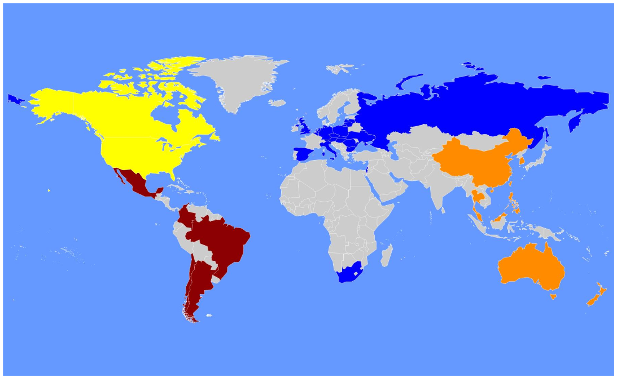
Recruitment
North America
n=3708 (25%)
190 sites
Europe
n=6788 (46%)
329 sites
Latin America
n=2727 (18%)
64 sites
Asia Pacific
n=1529 (10%)
104 sites
Total Randomised = 14752
Mentz RJ, et al. Am Heart J, 2017; 187: 1-9

Slide 20
Enrollment, Follow-up and Vital Status
15185 Enrolled
433 Screen-Failed
14752 patients randomised for ITT analysis
 | Exenatide n=7356 | Placebo n=7396
Completed Study | 7094 (96.4%) | 7093 (95.9%)
Withdrawn Consent | 223 (3.0%) | 270 (3.7%)
Lost to Follow-up | 39 (0.5%) | 33 (0.4%)
Vital Status Known | 7273 (98.9%) | 7308 (98.8%)

Slide 21
Baseline Characteristics
Characteristic | Exenatide n=7356 | Placebo n=7396
Age (years) | 62.0 (56.0, 68.0) | 62.0 (56.0, 68.0)
Female | 2794 (38.0) | 2809 (38.0)
Race
White | 5554 (75.5) | 5621 (76.0)
Black | 442 (6.0) | 436 (5.9)
Asian | 725 (9.9) | 727 (9.8)
Other | 633 (8.6) | 609 (8.2)
Body Mass Index (kg/m²) | 31.8 (28.2, 36.2) | 31.7 (28.2, 36.1)
eGFR (mL/min/1.73 m²)* | 76.6 (61.3, 92.0) | 76.0 (61.0, 92.0)
>90 | 2127 (29.0) | 2141 (29.0)
60 – 89 | 3642 (49.7) | 3604 (48.9)
30 – 59 | 1557 (21.2) | 1620 (22.0)
<30 | 8 (0.1) | 6 (0.1)
Values are median (IQR) for continuous variables or n / N (%) for categorical variables. Percentages presented are for available data.
*MDRD formula used to calculate eGFR. Site-reported values are presented.

Slide 22
Baseline Characteristics – Diabetes
Characteristic | Exenatide n=7356 | Placebo n=7396
Duration of diabetes (years) | 12.0 (7.0, 17.0) | 12.0 (7.0, 18.0)
HbA1c (%) | 8.0 (7.3, 8.9) | 8.0 (7.3, 8.9)
Oral antihyperglycaemic medication usage
None | 107 (1.5) | 121 (1.6)
Monotherapy | 3070 (41.7) | 3165 (42.8)
Dual therapy | 2469 (33.6) | 2452 (33.2)
≥ 3 oral agents | 674 (9.2) | 661 (8.9)
Insulin +/- oral agents | 3397 (46.2) | 3439 (46.5)
Values are median (IQR) for continuous variables or n / N (%) for categorical variables. Percentages presented are for available data.

Slide 23
Baseline Antihyperglycaemic Medication Usage
5618
5677
3397
3439
2697
2704
1118
1085
292
287
49
28
Includes medications taken alone or in combination. Percentages presented are for available data.
* Information regarding SGLT-2 inhibitor usage was added to the eCRF on 9th May, 2013. Percentages presented are for ITT population.

Slide 24
Baseline Characteristics – Cardiovascular Disease
Characteristic | Exenatide n=7356 | Placebo n=7396
Prior cardiovascular event* at randomisation | 5423 (73.7%) | 5401 (73.0%)
Coronary artery disease | 3898 (53.0%) | 3896 (52.7%)
Cerebrovascular disease | 1233 (16.8%) | 1276 (17.3%)
Peripheral arterial disease | 1400 (19.0%) | 1400 (18.9%)
History of congestive heart failure | 1161 (15.8%) | 1228 (16.6%)
Percentages presented are for available data.
* At least one of:
History of MI, coronary revascularisation procedure, or at least one stenosis ≥50% in a major epicardial artery or branch vessel on coronary angiography
History of ischaemic stroke or ≥50% carotid artery stenosis documented via imaging
Atherosclerotic peripheral arterial disease: amputation, ABPI or TBPI <0.9 or peripheral revascularisation procedure

Slide 25
Baseline Cardiovascular Medication Usage
5674
5724
5442
5393
5465
5380
4082
4129
Percentages presented are for available data.

Slide 26
Participant Follow-Up
 | Exenatide n=7356 | Placebo n=7396
Study Duration Median (IQR), years | 3.3 (2.3, 4.4) | 3.2 (2.2, 4.3)
Premature Study Medication Discontinuation* n (%) | 3164 (43.0) | 3343 (45.2)
Study Treatment Duration Median (IQR), years | 2.4 (1.4, 3.8) | 2.3 (1.2, 3.6)
Proportion of Time on Study Medication Mean (SD), % | 76.0 (35.3) | 75.0 (35.1)
* Site-reported premature permanent discontinuation of study medication

Slide 27
Changes in key risk factors

Slide 28
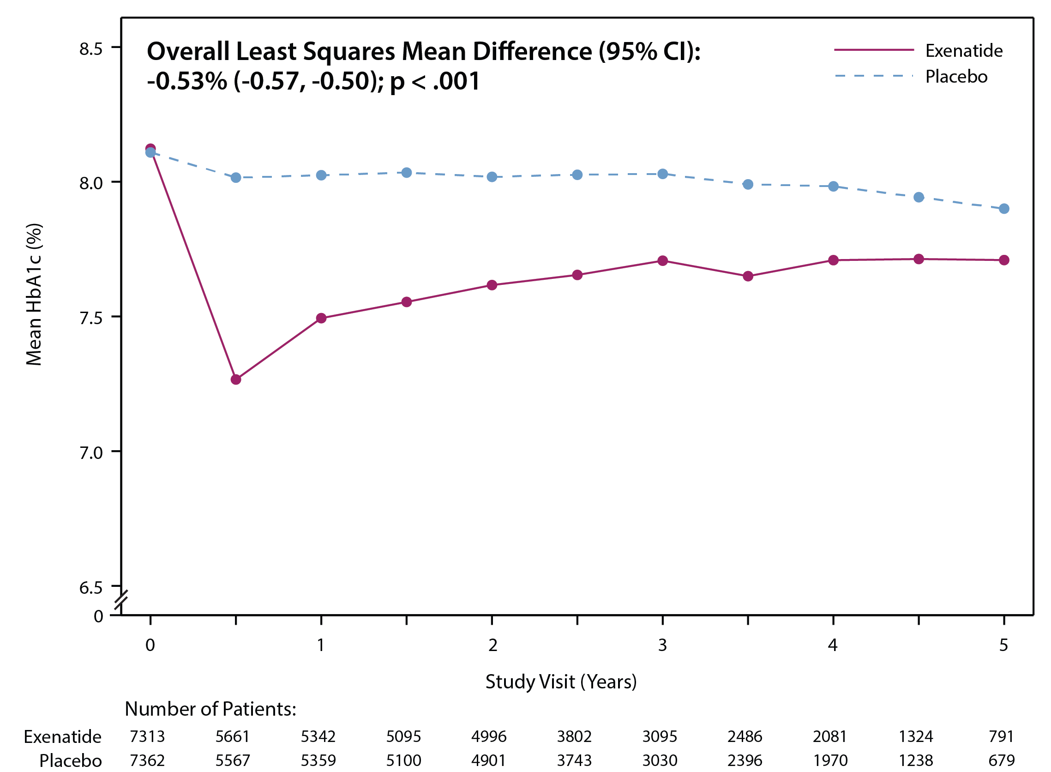
Between Group HbA1c Differences Over Time
Aim was for glycaemic equipoise, but not required
Choice and adjustment of antihyperglycaemic concomitant medication was at the discretion of the usual care provider in line with local/national guidelines
Only GLP-1 RA prohibited
Adjustment of antihyperglycaemic regimen was limited until “HbA1c levels reflected the initial effects of randomised study medication”
Overall least squares mean difference was estimated from the model including only patients with baseline and at least one post-baseline measure

Slide 29
Time To Initiation Of Next Antihyperglycaemic Agent
 | Exenatide N=7356 | Placebo N=7396 | Hazard Ratio (95% CI) | P value
Initiation of any co-interventional antihyperglycaemic agent (oral agent, insulin therapy, or both) | 2042 (27.8%) | 2736 (37.0%) | 0.67 (0.63, 0.71) | <.001
First event rate per 100 pt-years | 10.5 | 15.7 | - | -
Initiation of additional oral antihyperglycaemic agent * | 1743 (23.7%) | 2289 (30.9%) | 0.70 (0.66, 0.75) | <.001
First event rate per 100 pt-years | 8.6 | 12.2 | - | -
Initiation of first chronic insulin therapy | 515 (7.0%) | 811 (11.0%) | 0.61 (0.54, 0.68) | <.001
First event rate per 100 pt-years | 2.3 | 3.8 | - | -
* Oral antihyperglycemic agents included Biguanides, Sulfonylureas, Thiazolidinediones, Non-sulfonylurea secretagogues, Alpha-glucosidase inhibitors, GLP-1 receptor agonists, SGLT-2 inhibitors, DPP-4 inhibitors, and ‘Other’ antihyperglycemic agents. Information regarding SGLT-2 inhibitor usage and 'other’ antihyperglycemic agent usage was added to the eCRF on 09may2013. Subjects were assumed to have not taken those medications in cases where the medication variable at baseline is missing.

Slide 30
New Antihyperglycaemic Medication Usage
652
508
450
356
Subjects are considered to have taken a new medication if there is no indication of usage at baseline visit as well as indication of usage during at least one post-randomisation visit. Percentages presented are for available data.
* Information regarding SGLT-2 inhibitor usage was added to the eCRF on 9th May, 2013. Percentages presented are for ITT population.
** Includes GLP-1 receptor agonist usage other than study medication

Slide 31
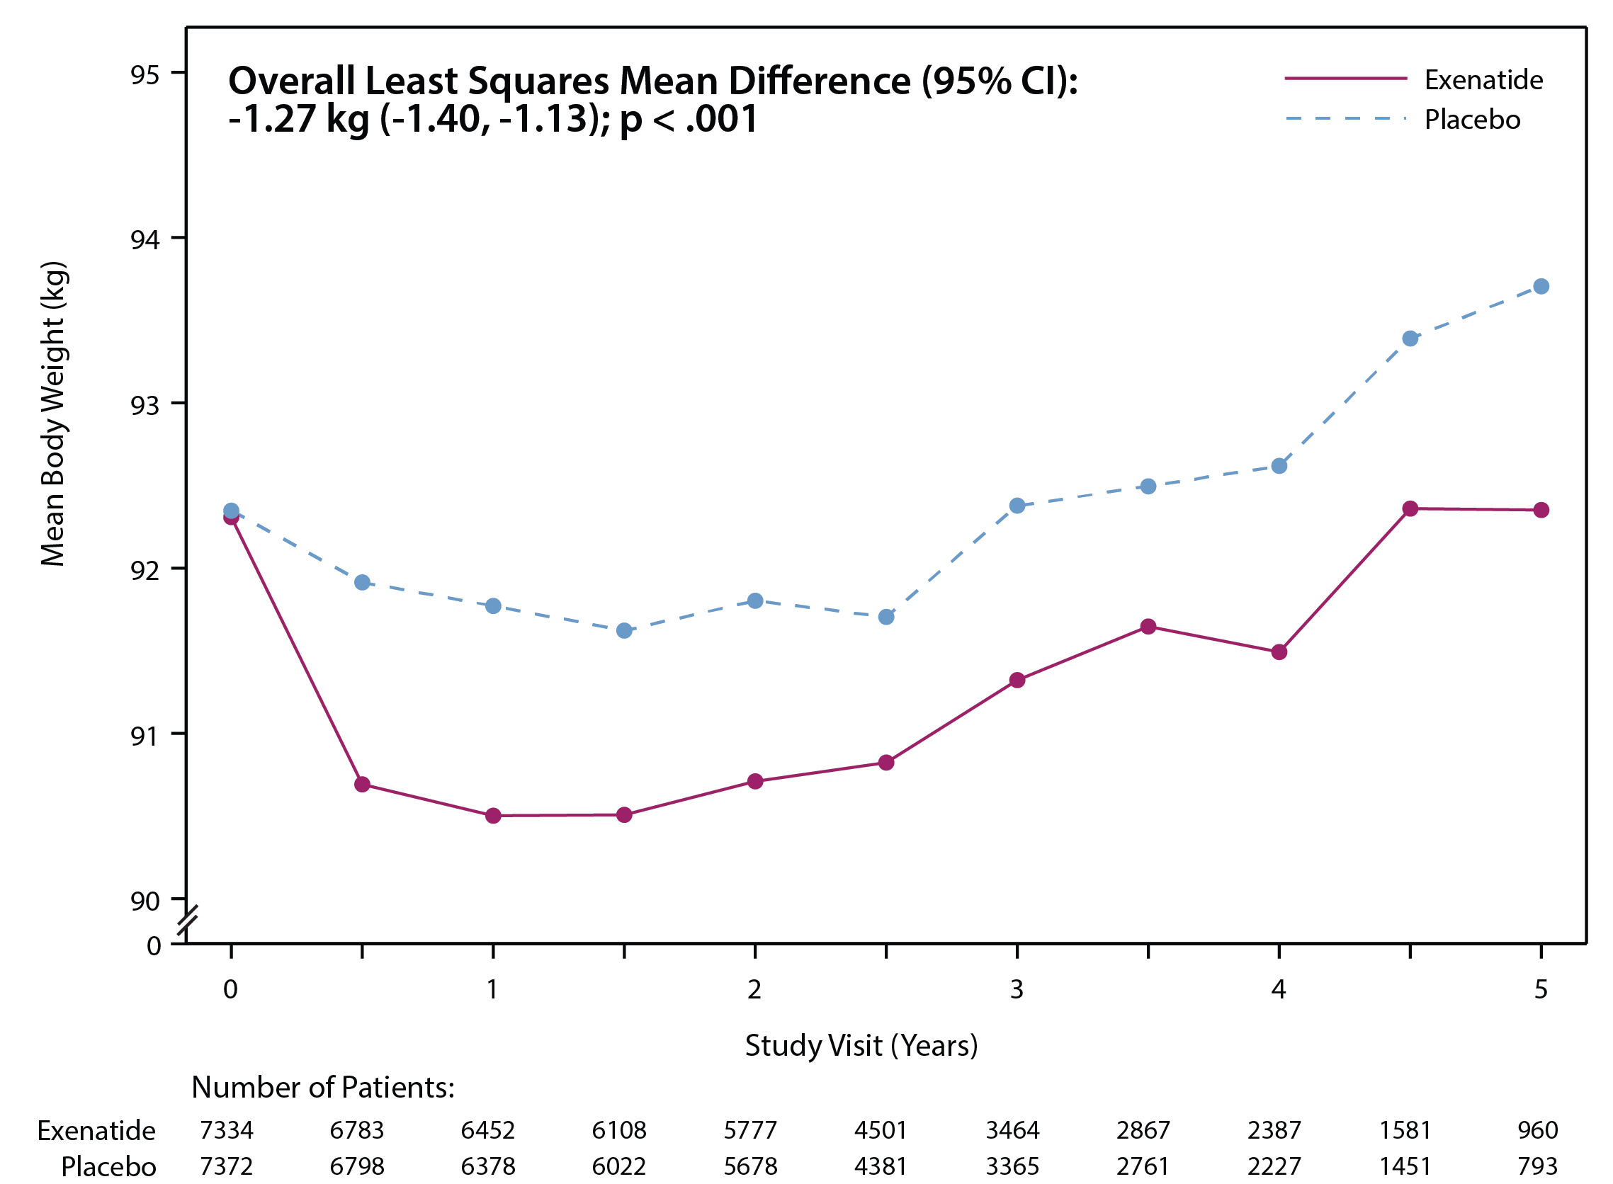
Between Group Body Weight Differences Over Time
Overall least squares mean difference was estimated from the model including only patients with baseline and at least one post-baseline measure

Slide 32
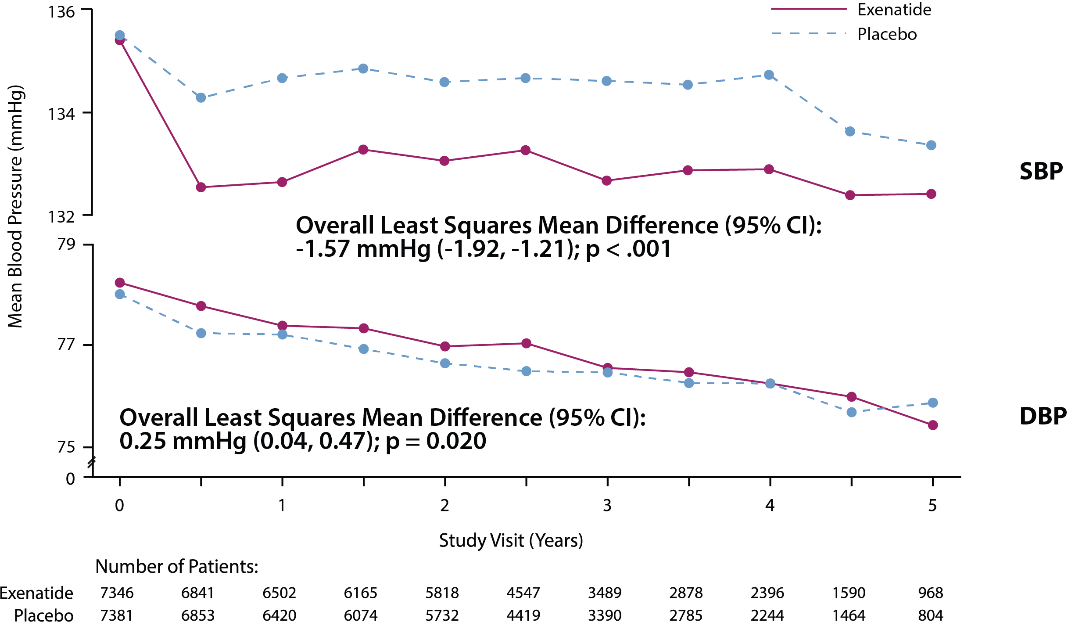
Between Group Blood Pressure Differences Over Time
Overall least squares mean difference was estimated from the model including only patients with baseline and at least one post-baseline measure
Notes:
DBP:
Box/EXSCEL DTU-DCRI-AZ/Top Line Results_stats/Manuscript Figures/Figures revised by graphics/Fig S8_f_line_dbp_itt-outline.pdf

Slide 33
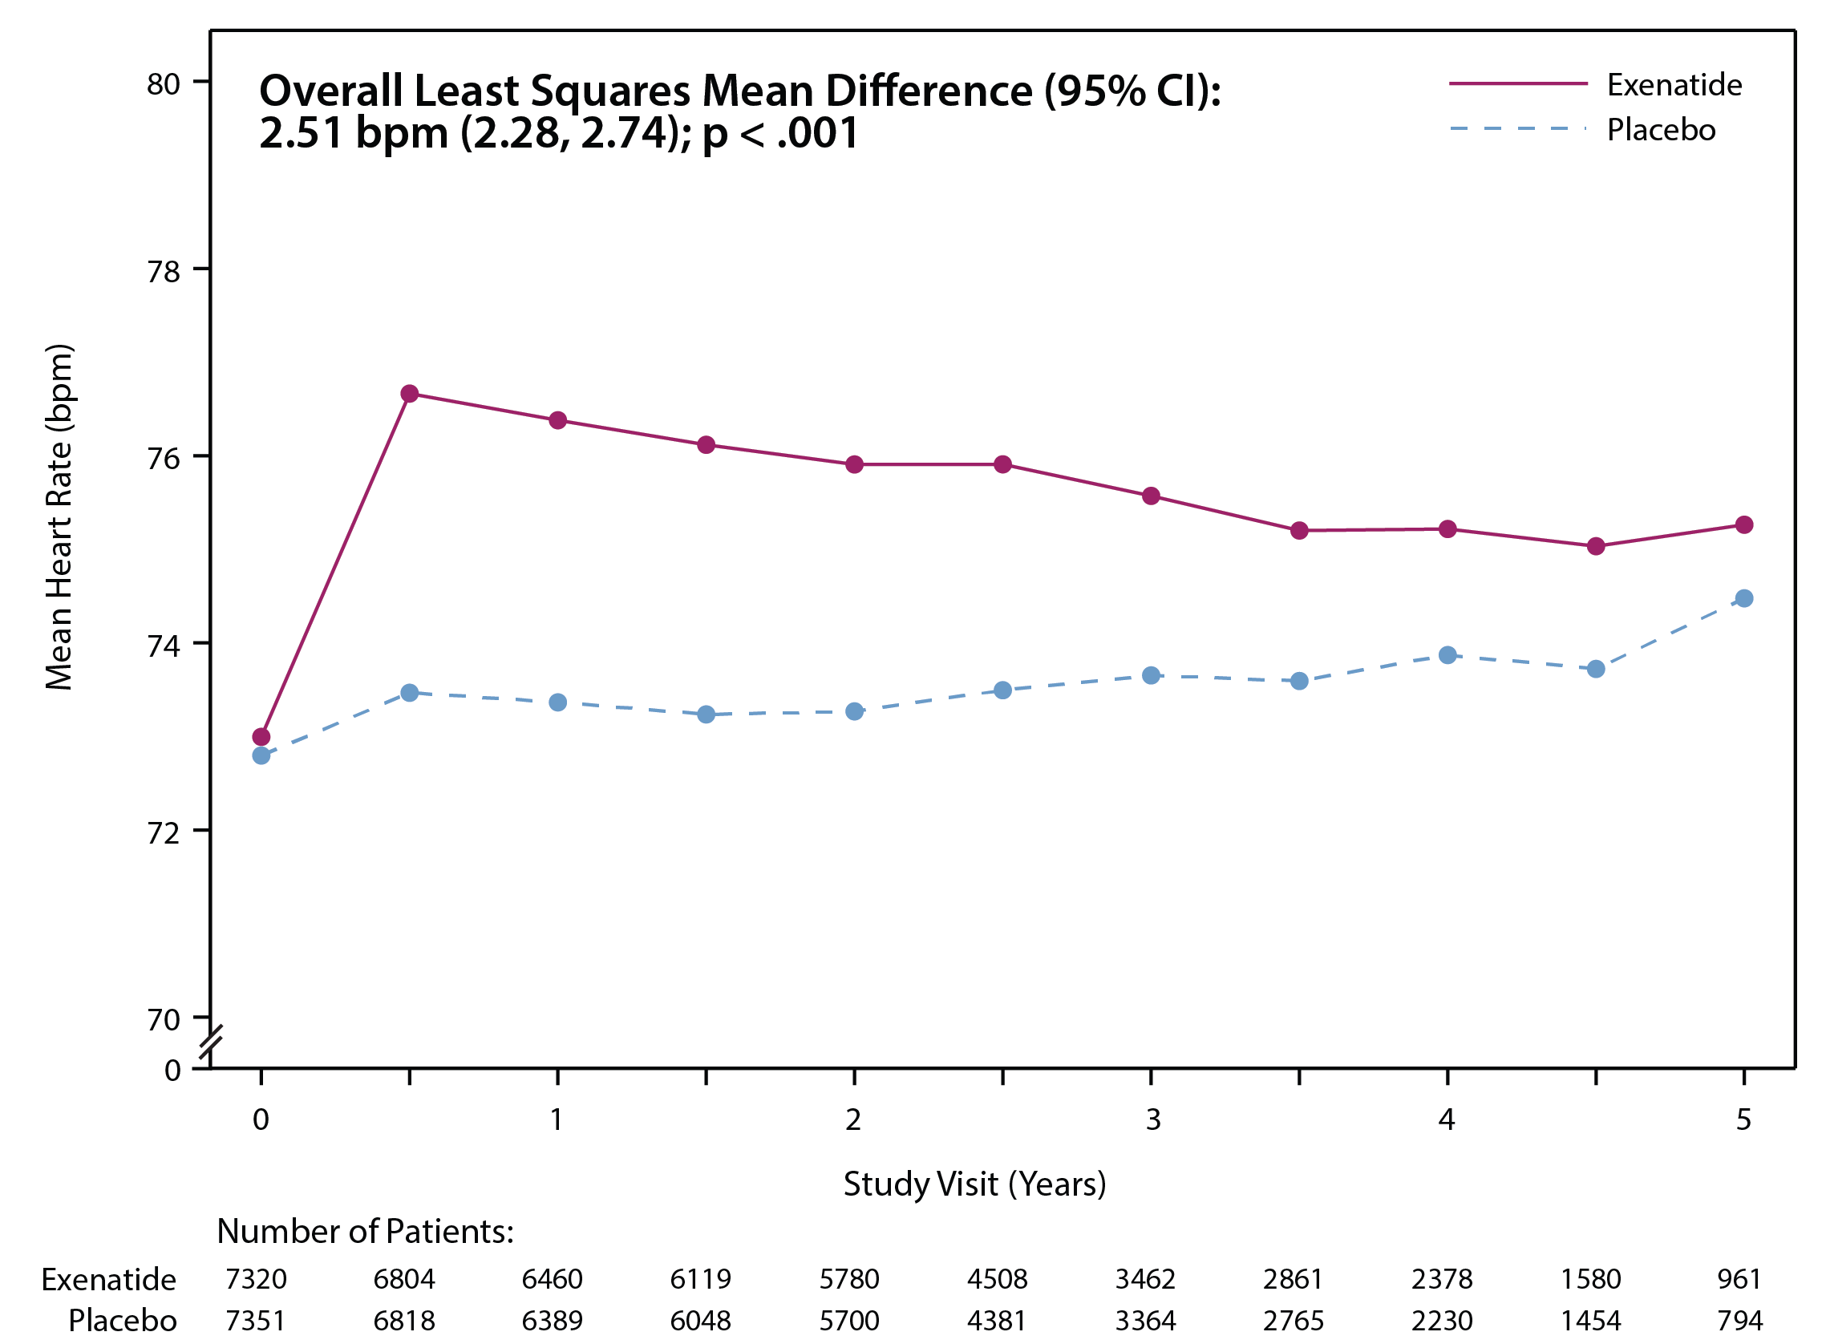
Between Group Heart Rate Differences Over Time
Overall least squares mean difference was estimated from the model including only patients with baseline and at least one post-baseline measure

Slide 34
Safety Data
Bernard Zinman, MD
Lunenfeld Tanenbaum Research Institute, University of Toronto

Slide 35
Presenter Disclosure Information
Grant support:
  Boehringer-Ingelheim, AstraZeneca, Novo Nordisk
Consulting fees:
  AstraZeneca, Boehringer-Ingelheim, Eli Lilly, Janssen, Merck, Novo Nordisk, Sanofi Aventis

Slide 36
General Principles
All data presented in this section relate to the Safety Population (participants in the Intention-to-Treat population who took at least one dose of study medication)
SAEs were recorded in detail
Non-serious AEs were not generally recorded (only pancreatitis and neoplasms)
Clinical events of interest (exempt from traditional AE/SAE collection and reporting):
  CV events (e.g. procedures, hospitalisations)
  Diabetic complications (e.g. retinopathy, blindness, amputation, neuropathy, albuminuria, end stage renal failure)
  Expected events (e.g. infection, metabolic conditions associated with diabetes such as hyperlipidemia/dyslipidemia, hypertension, and gout)

Slide 37
SAEs
Subjects with one or more: | Exenatide N=7344 | Placebo N=7372
Serious adverse event (SAE) | 1234 (16.8%) | 1222 (16.6%)
SAE related to study treatment | 56 (0.8%) | 38 (0.5%)
SAE resulting in permanent treatment discontinuation | 108 (1.5%) | 104 (1.4%)
All SAEs collected via AE reporting (non-adjudicated).

Slide 38
Diabetes Complications
 | Exenatide n=7344 | Placebo N=7372
Any diabetes complication | 1341 (19.0%) | 1403 (19.8%)
Amputation (non-traumatic) | 128 (1.7%) | 127 (1.7%)
Retinopathy | 214 (2.9%) | 238 (3.2%)
Blindness due to diabetes | 8 (0.1%) | 9 (0.1%)
Other diabetic eye disease | 201 (2.7%) | 195 (2.6%)
Albuminuria | 662 (9.4%) | 724 (10.3%)
Microalbuminuria | 505 (7.2%) | 527 (7.5%)
Macroalbuminuria | 154 (2.2%) | 196 (2.8%)
Diabetic neuropathy | 329 (4.5%) | 318 (4.3%)
End stage renal failure needing chronic peritoneal/hemodialysis or renal transplantation | 55 (0.7%) | 64 (0.9%)
Percentages presented for each event are for available data.
All events collected via AE reporting (non-adjudicated).

Slide 39
Severe* Hypoglycaemia
 | Exenatide N=7344 | Placebo N=7372 | Risk Ratio (95% CI) | P value
All severe hypoglycaemia events | 404 | 450 | 0.85 (0.67, 1.08) | 0.189
Incident severe hypoglycaemia
Subjects with a severe hypoglycaemia event | 247 (3.4%) | 219 (3.0%) | - | -
Incidence rate per 100 pt-years | 1.0 | 0.9 | - | -
Recurrent severe hypoglycaemia
Number of events per subject:
1 | 185 | 148 | - | -
2 | 39 | 40 | - | -
≥3 | 23 | 31 | - | -
Rate of recurrence per 100 pt-years | 1.6 | 1.8 | - | -
*Hypoglycaemia requiring assistance.
All hypoglycaemia events collected via AE reporting (non-adjudicated).

Slide 40
Pancreatitis: Confirmed by Adjudication
 | Exenatide N=7344 | Placebo N=7372
Subjects with acute pancreatitis | 26 (0.4%) | 22 (0.3%)
Severe | 2 (<0.1%) | 2 (<0.1%)
Mild | 23 (0.3%) | 20 (0.3%)
Unknown | 1 (<0.1%) | 0 (0.0%)
First event rate per 100 pt-years | 0.11 | 0.09

Slide 41
Malignancy: Confirmed by Adjudication
 | Exenatide N=7344 | Placebo N=7372
Subjects with a CEC charter defined malignancy* | 355 (4.8%) | 361 (4.9%)
First event rate per 100 pt-years | 1.5 | 1.6
All charter defined malignancy events | 429 | 442
*Newly diagnosed malignancy or 1st recurrence of previously diagnosed malignancy during the study period.

Slide 42
Malignancies of Interest: Confirmed by Adjudication
 | Exenatide N=7344 | Placebo N=7372
Pancreas | 15 (0.2%) | 16 (0.2%)
Thyroid | 14 (0.2%) | 6 (0.1%)
Medullary * | 2 | 1
Papillary | 10 | 4
Follicular | 2 | 0
Other/Unknown | 0 | 1
* All 3 cases of medullary thyroid cancer were in participants with an elevated calcitonin value at baseline

Slide 43
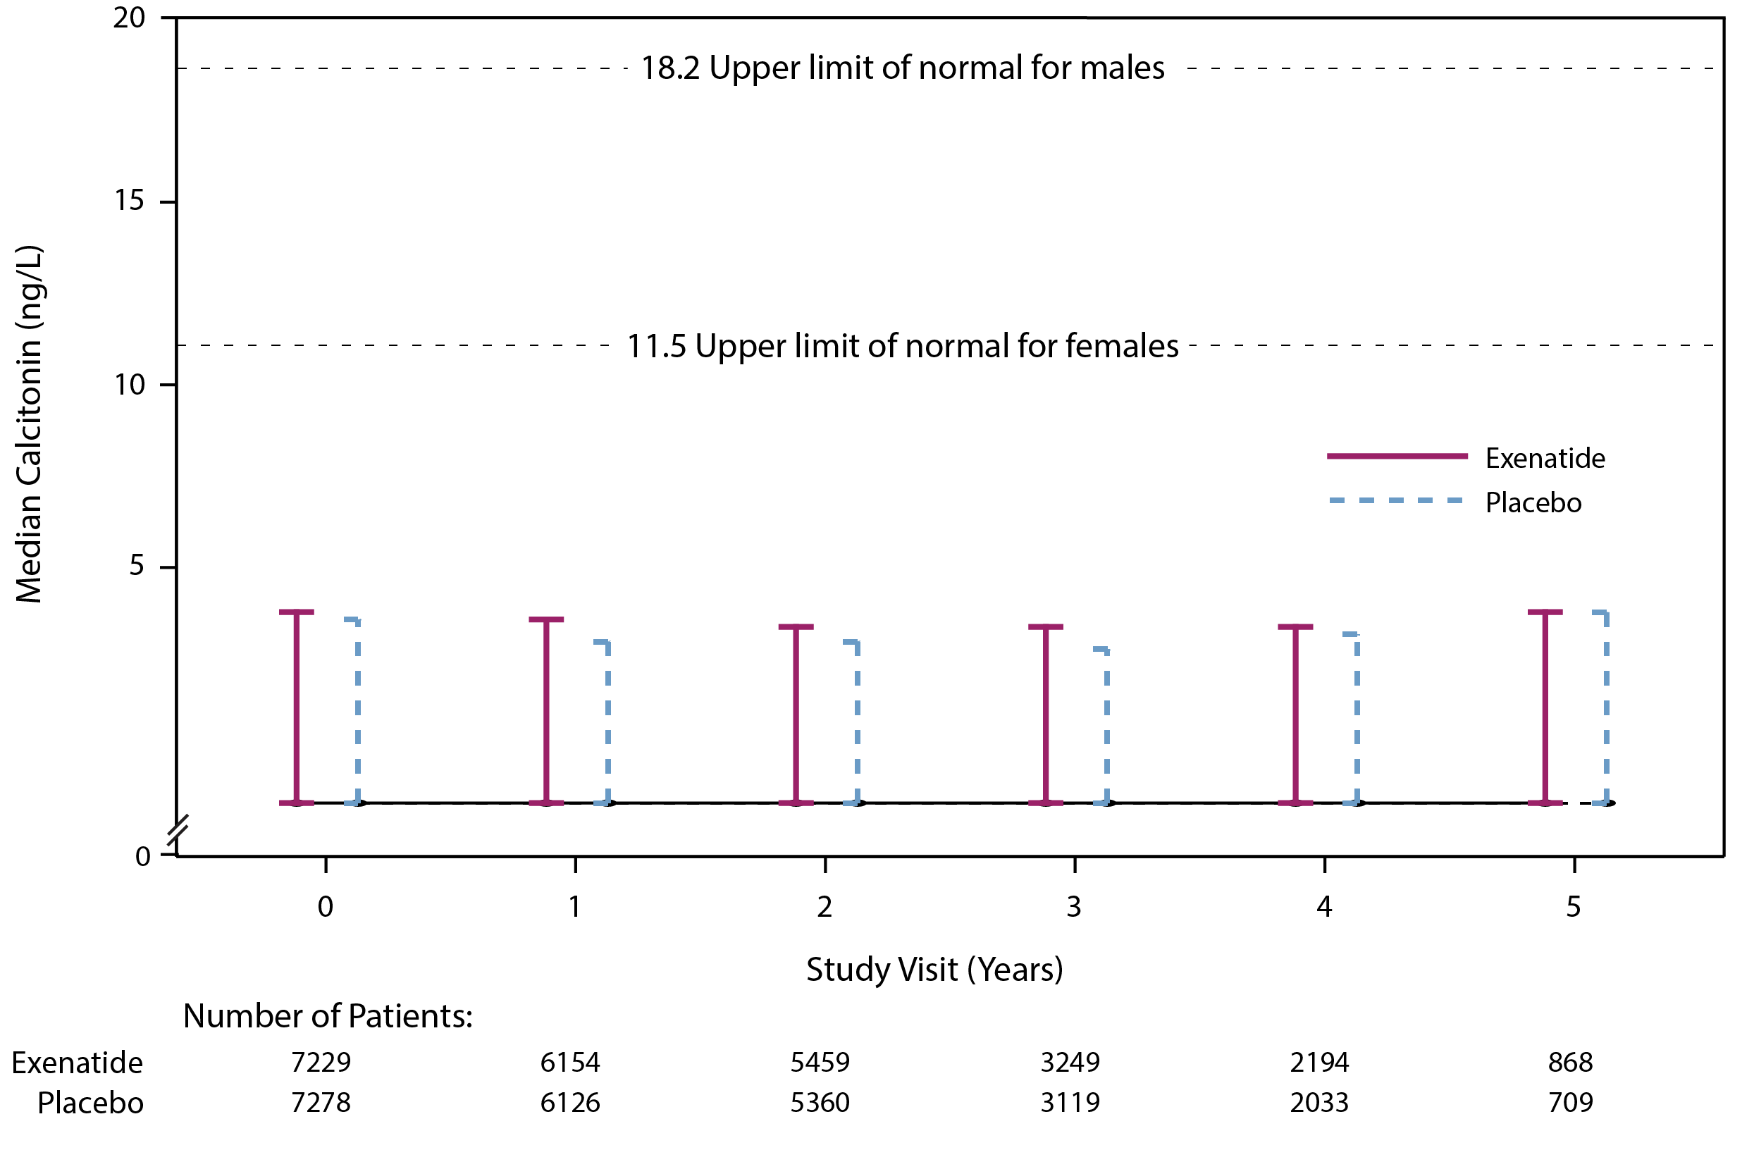
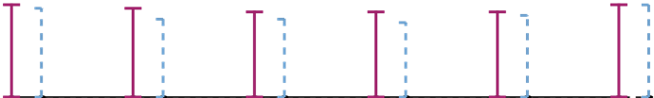
Change in Calcitonin Over Time

Slide 44
Cardiovascular Outcomes
Adrian F. Hernandez, MD
Duke Clinical Research Institute

Slide 45
Presenter Disclosure Information
Research funding:
  AstraZeneca, GlaxoSmithKline, Merck
Consulting fees:
Amgen, AstraZeneca, Bayer, Boehringer-Ingelheim, Merck, Sanofi Aventis

Slide 46
Primary Endpoint

Slide 47
Primary Endpoint
Time to first occurrence of 3-point MACE composed of:
  CV death
  Non-fatal MI
  Non-fatal stroke
Safety hypothesis (non-inferiority) and efficacy hypothesis (superiority)

Slide 48
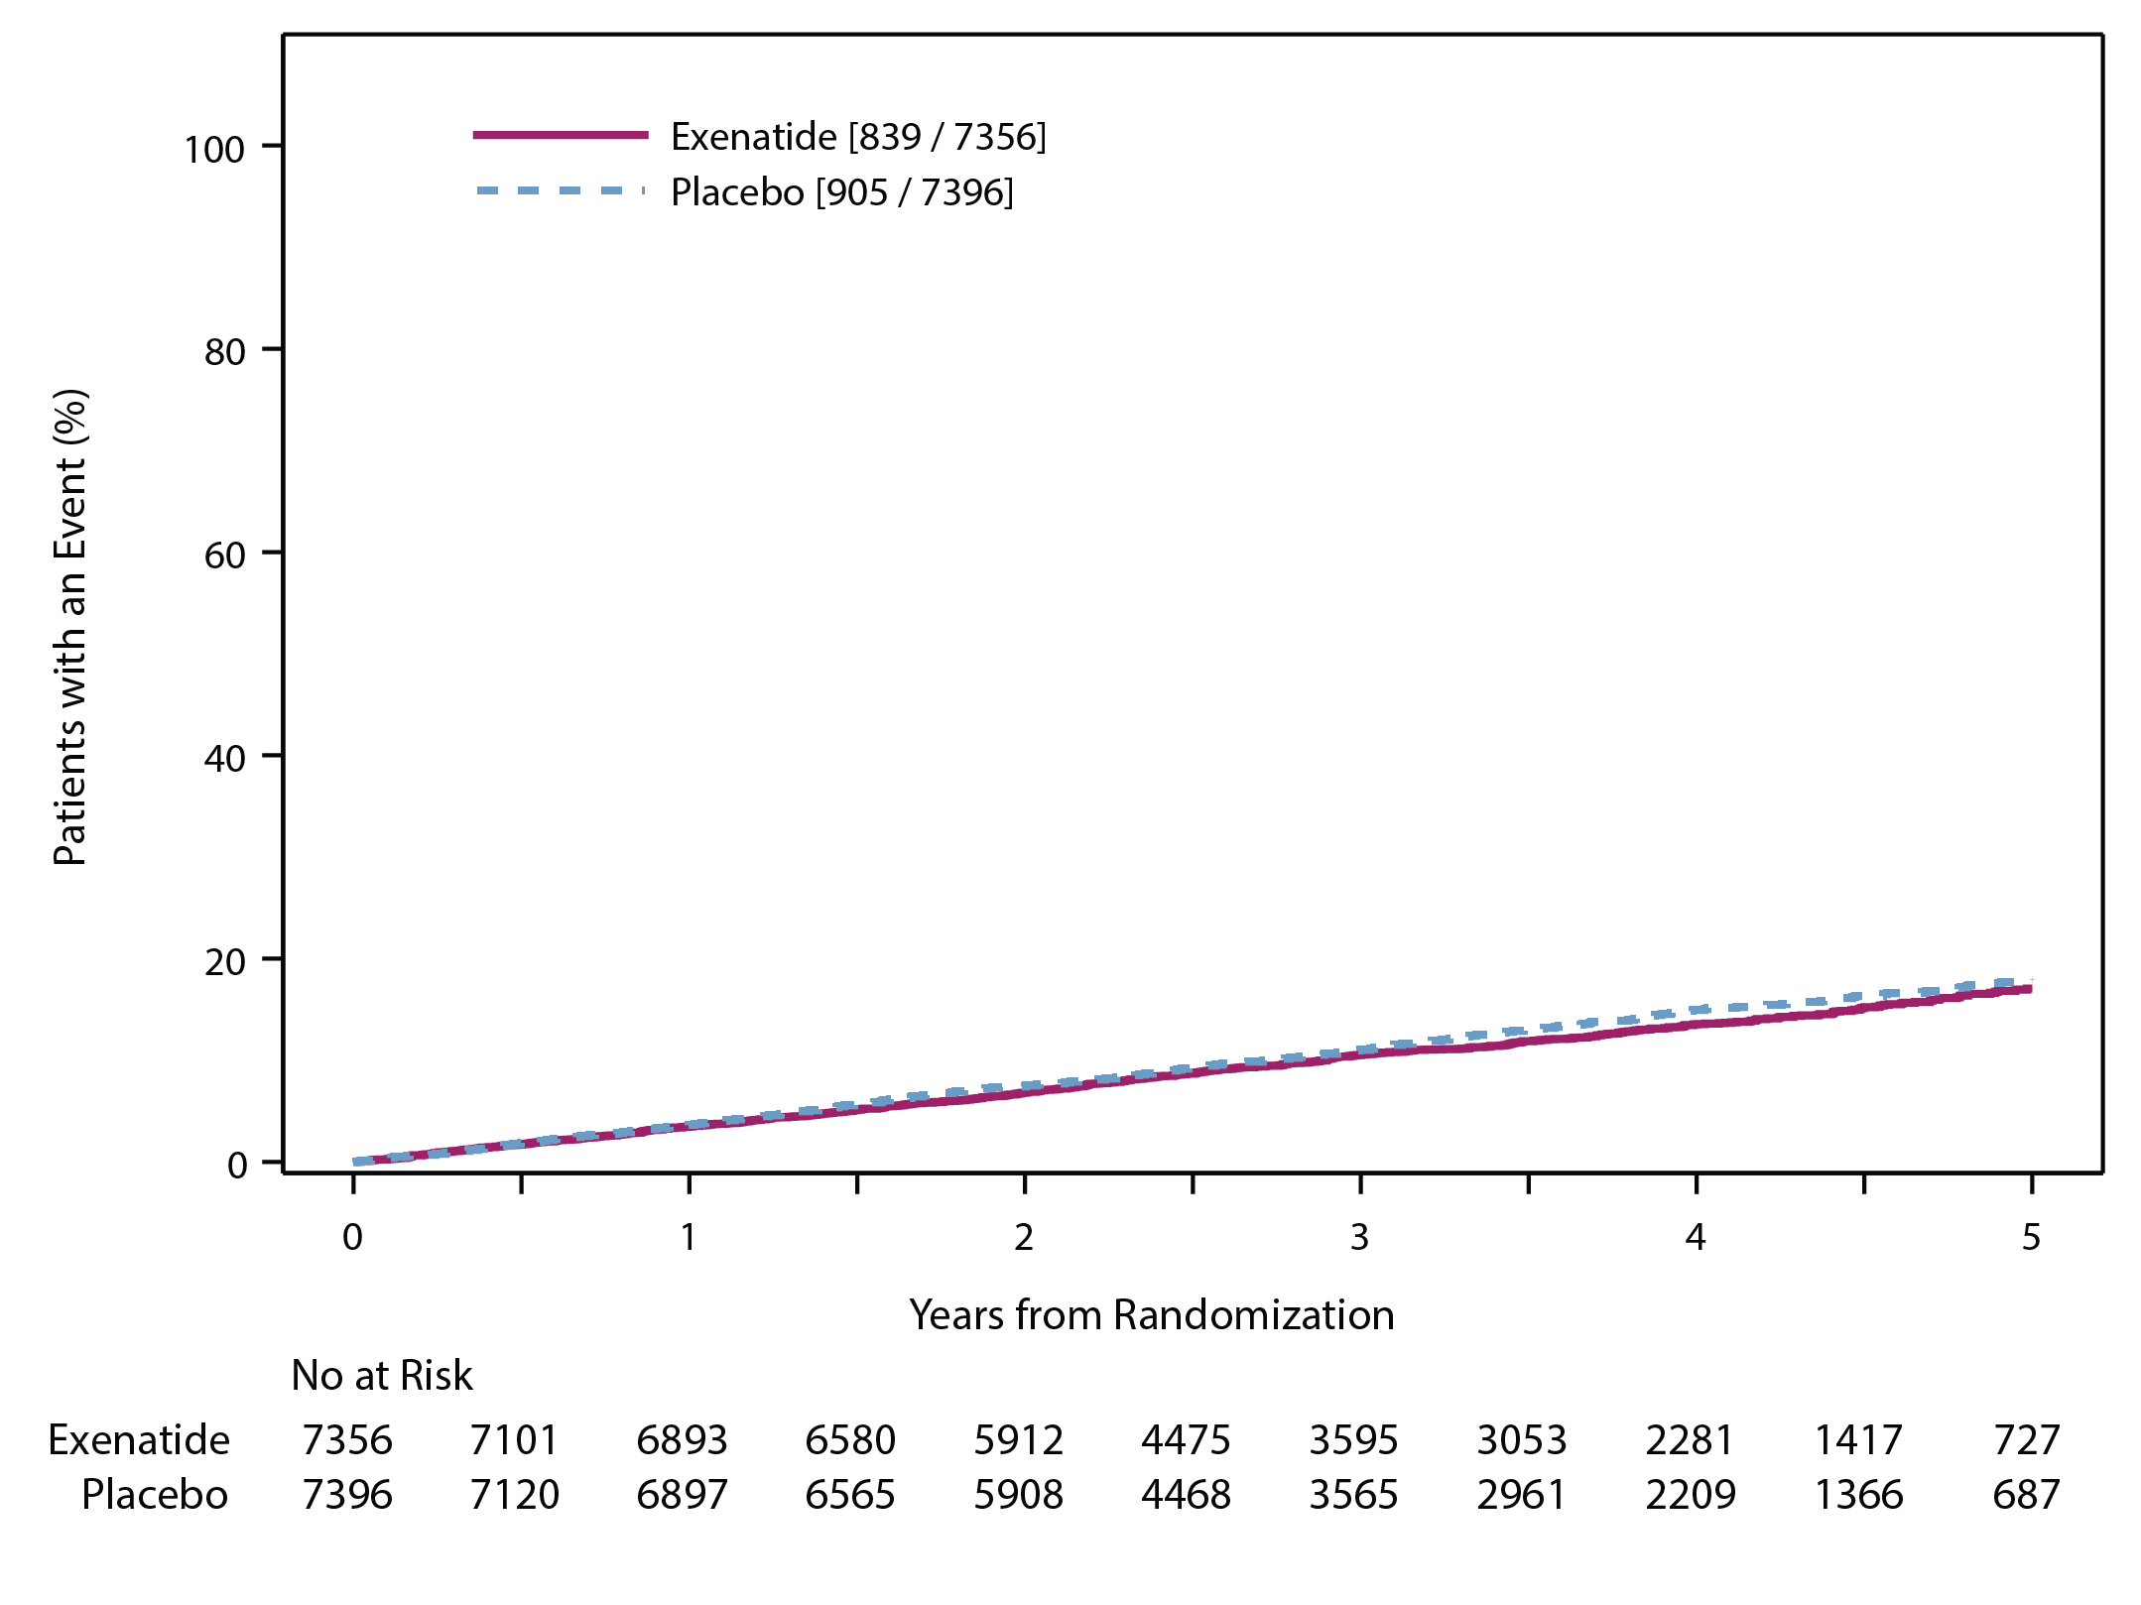
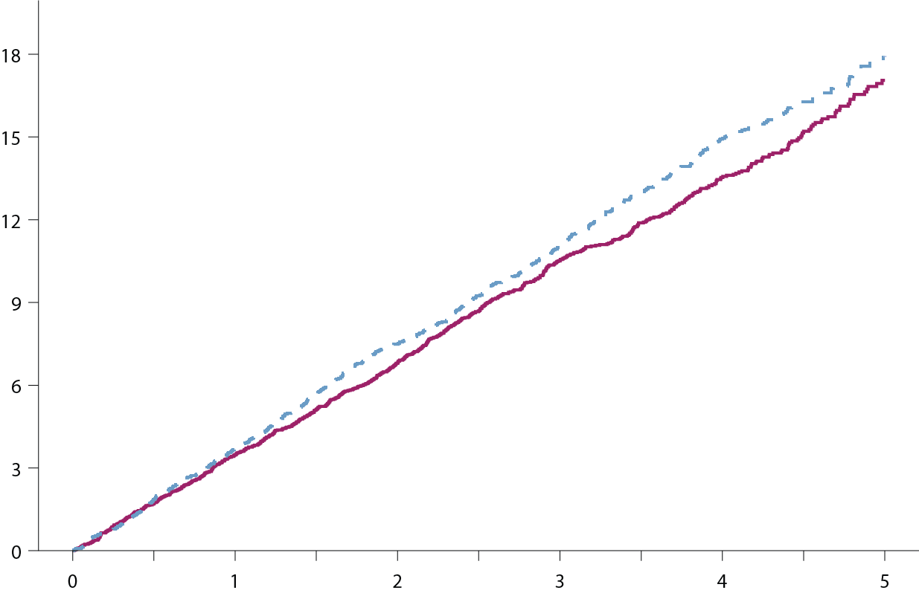
Primary Composite Cardiovascular Outcome
Intention-to-Treat Analysis for Non-inferiority & Superiority
HR (95% CI) 0.91 (0.83, 1.00)
P value (non-inferiority) <.001
P value (superiority) 0.061
Notes:
Box/EXSCEL DTU-DCRI-AZ/Top Line Results_stats/Manuscript Figures/Figures revised by graphics/EXSCEL-manuscript-Fig2_29jun2017-rev1-outline.pdf – PANEL A

Slide 49
Primary Composite Cardiovascular Outcome
Intention-to-Treat Analysis
Exenatide
N=7356
Placebo
N=7396
Hazard Ratio
95% CI
P value
<.001
(non-inferiority)
0.061
(superiority)
839 (11.4%)
3.7 per 100 pt-yrs
905 (12.2%)
4.0 per 100 pt-yrs
MACE
0.91
0.83, 1.00
CV-death
229
(3.1%)
258
(3.5%)
0.88
0.73, 1.05
0.628 (homogeneity among components)
Non-fatal MI
455
(6.2%)
470
(6.4%)
0.95
0.84, 1.09
Non-fatal stroke
155
(2.1%)
177
(2.4%)
0.86
0.70, 1.07
Exenatide
favoured
Placebo
favoured

Slide 50
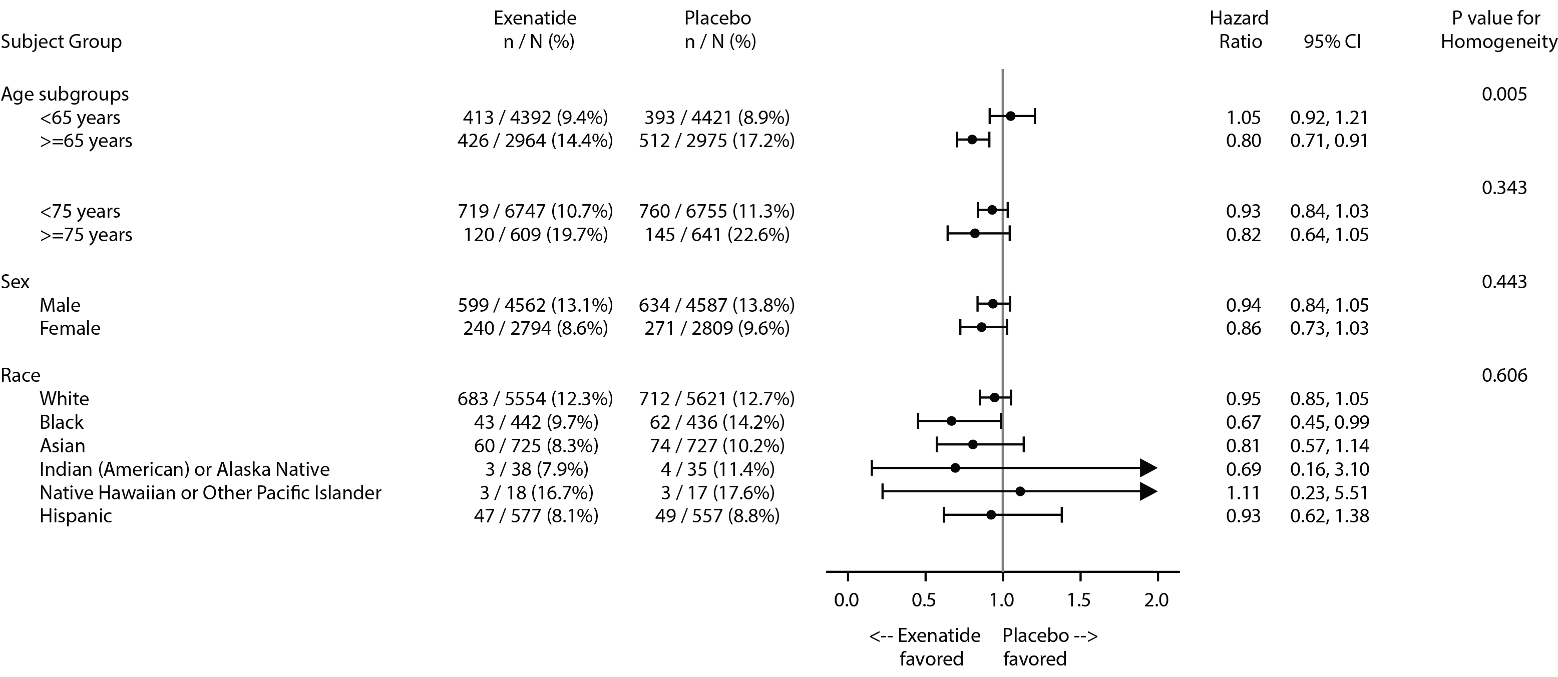
Primary Composite Cardiovascular Outcome
Prespecified Subgroup Analyses (Intention-to-Treat Population)
(1)
Forest plot of primary endpoint by predefined patient subgroups
Notes:
Figure 3 in the primary results manuscript

Slide 51
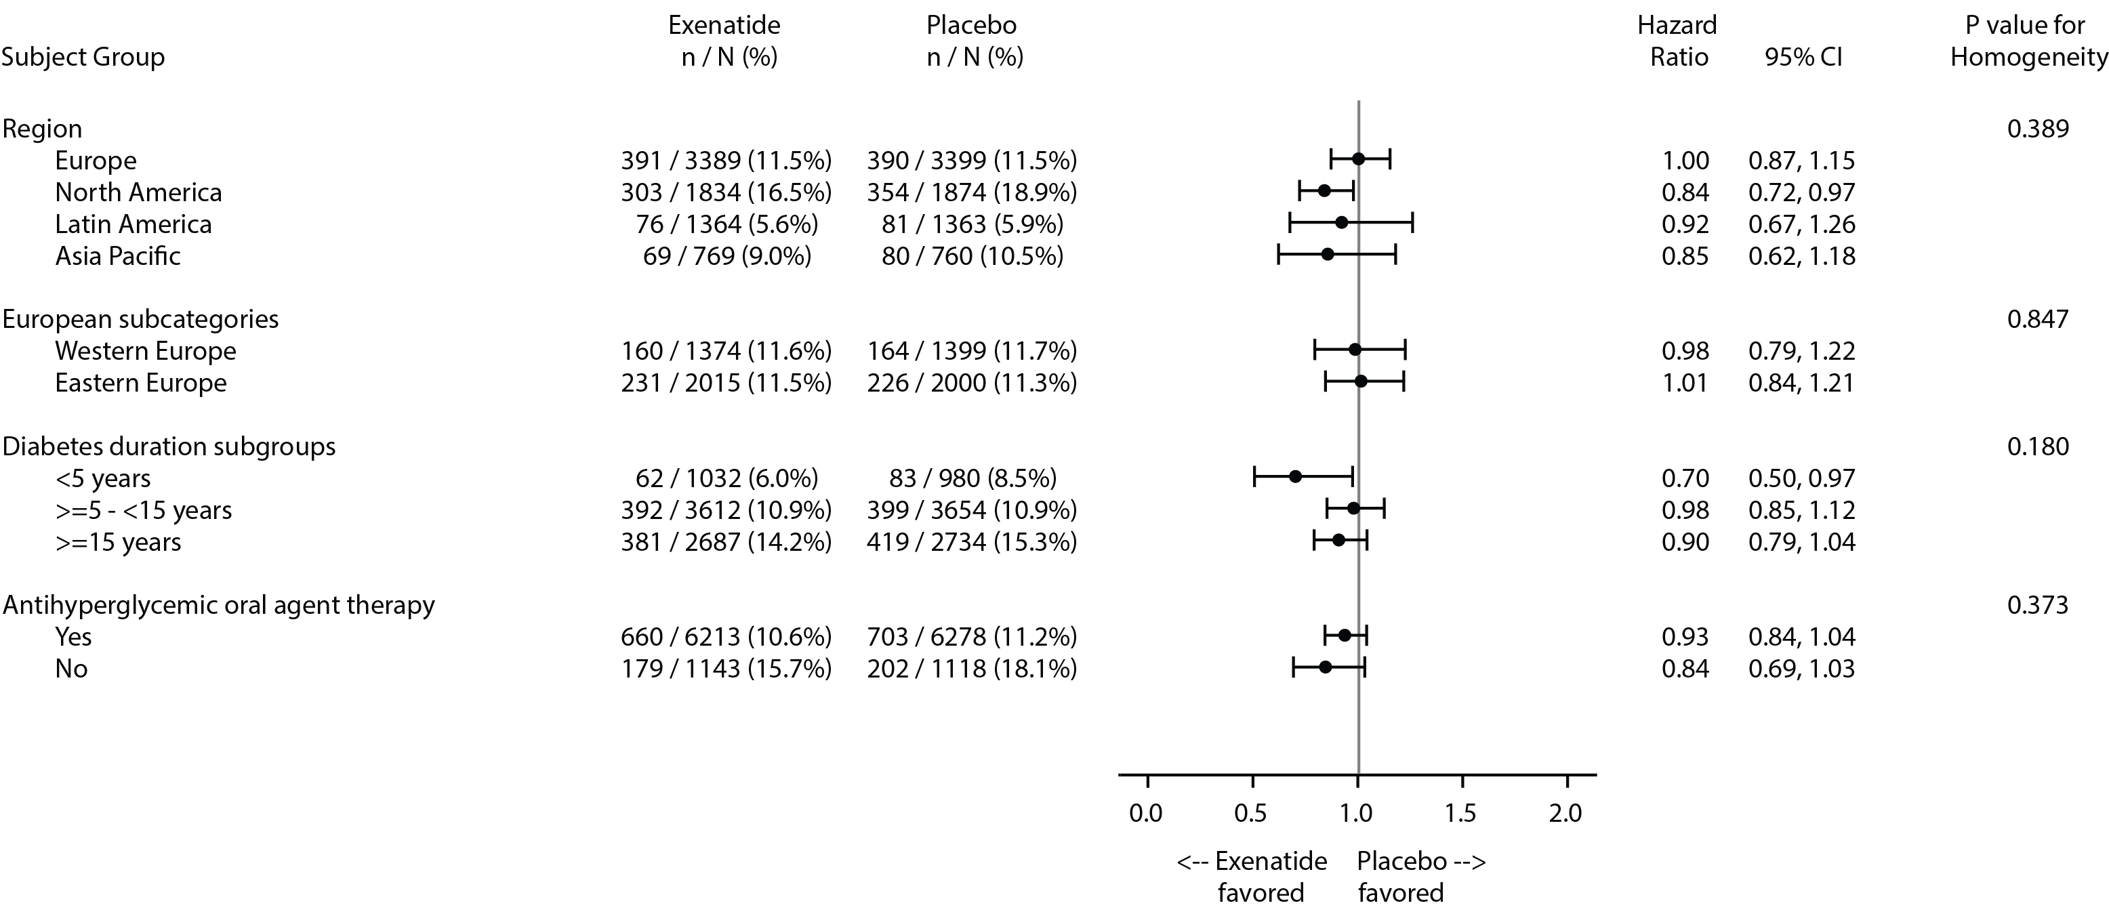
Primary Composite Cardiovascular Outcome
Prespecified Subgroup Analyses (Intention-to-Treat Population)
(2)
Forest plot of primary endpoint by predefined patient subgroups
Notes:
Figure 3 in the primary results manuscript

Slide 52
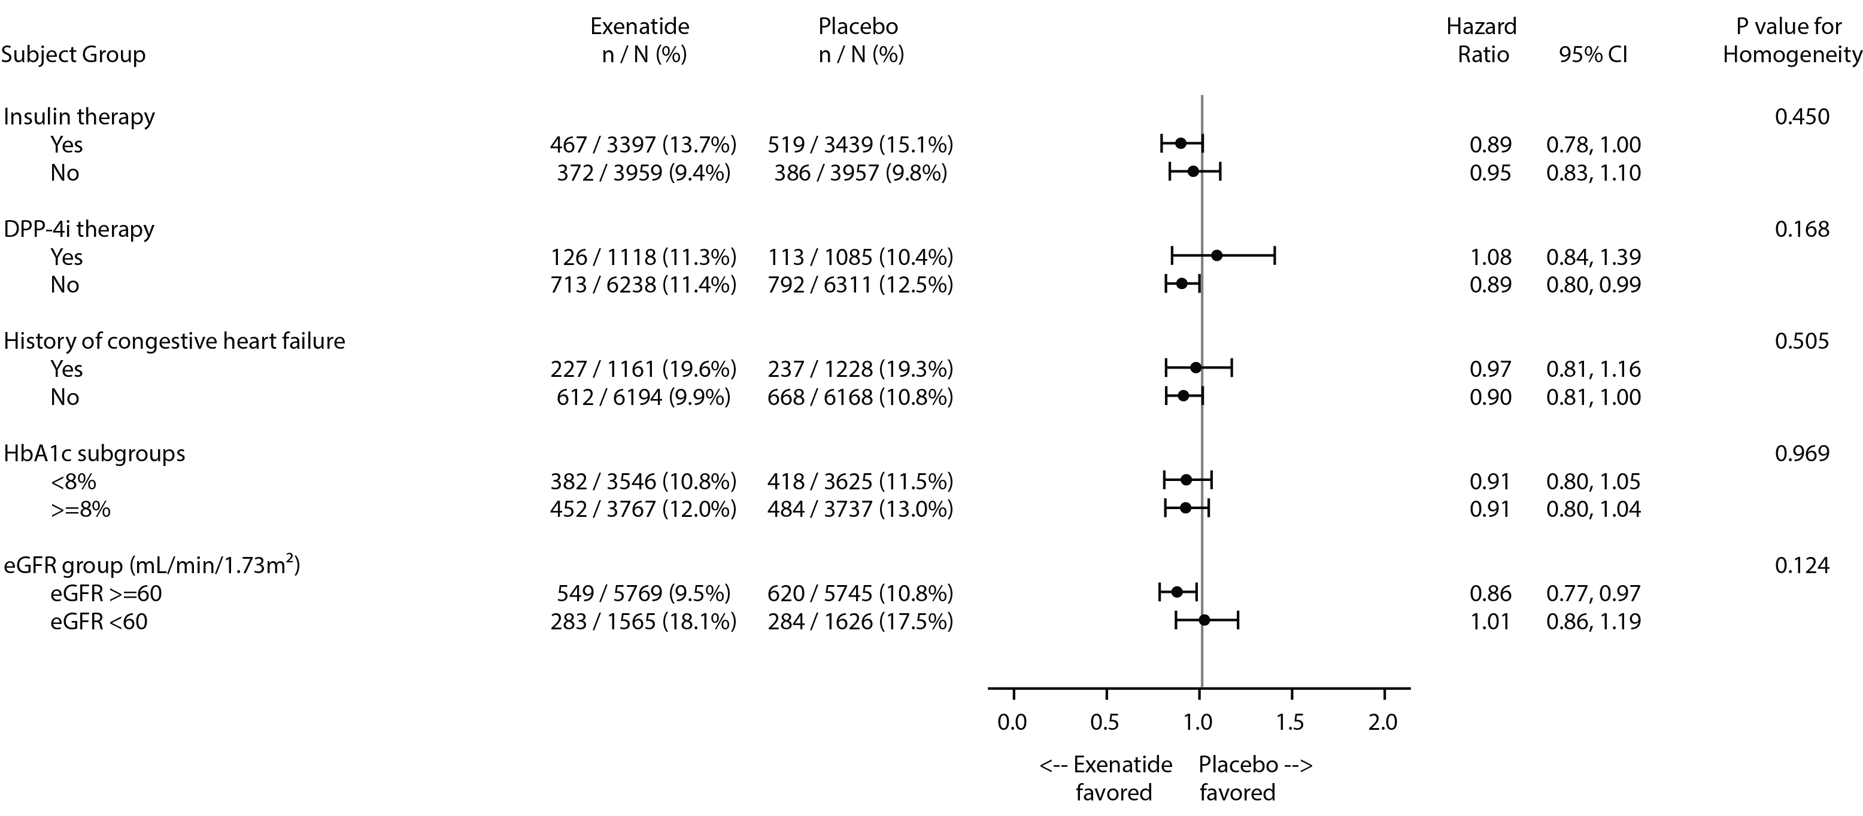
Primary Composite Cardiovascular Outcome
Prespecified Subgroup Analyses (Intention-to-Treat Population)
(3)
Forest plot of primary endpoint by predefined patient subgroups

Slide 53
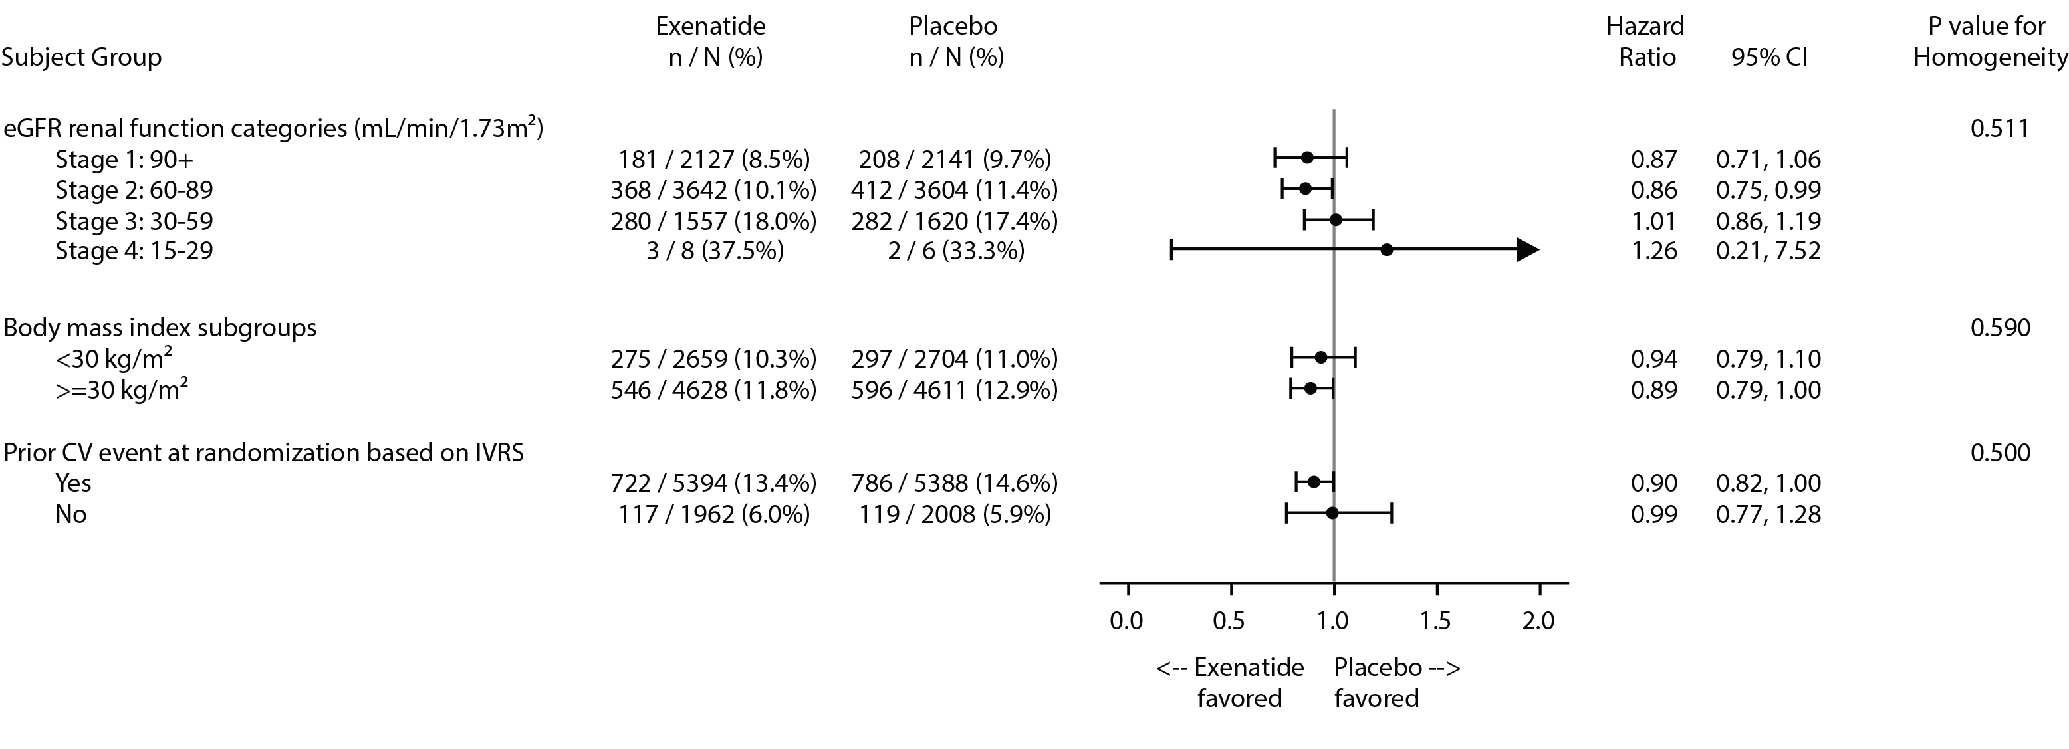
Primary Composite Cardiovascular Outcome
Prespecified Subgroup Analyses (Intention-to-Treat Population)
(4)
Forest plot of primary endpoint by predefined patient subgroups
Notes:
Figure 3 in the primary results manuscript

Slide 54
Secondary Endpoints

Slide 55
Secondary Endpoints
Time to first occurrence of:
  All-cause mortality
  CV-related death
  Fatal or non-fatal MI
  Fatal or non-fatal stroke
  Hospitalisation for acute coronary syndrome (ACS)
  Hospitalisation for heart failure (HF)

Slide 56
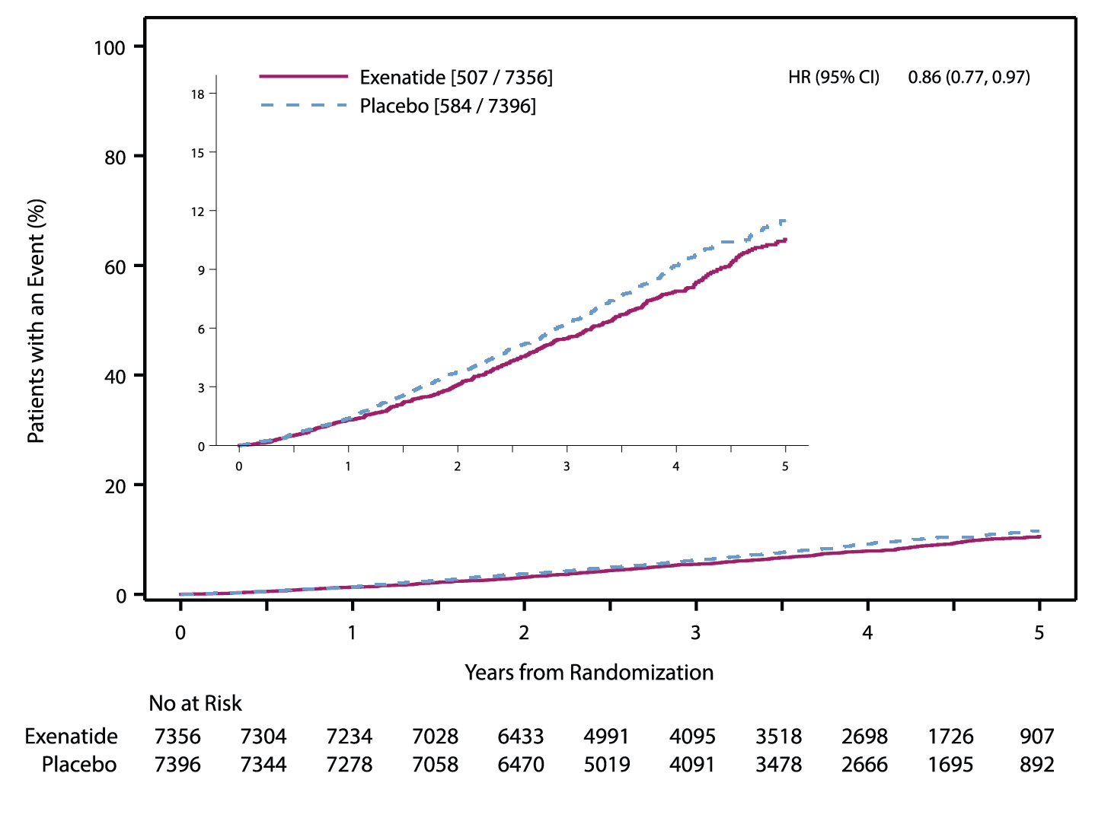
All-Cause Mortality
Intention-to-Treat Analysis
HR (95% CI) 0.86 (0.77, 0.97)
P value 0.016
Notes:
Box/EXSCEL DTU-DCRI-AZ/Top Line Results_stats/Manuscript Figures/Figures revised by graphics/EXSCEL-manuscript-Fig2_29jun2017-rev1-outline.pdf – PANEL B

Slide 57
All-Cause Mortality: Modalities of Death (Intention-to-Treat Population)
 | Exenatide N=7356 | Placebo N=7396
No. of all cause death events | 507 (6.9%) | 584 (7.9%)
Cardiovascular death | 230 (3.1%) | 241 (3.3%)
Non-cardiovascular death | 167 (2.3%) | 201 (2.7%)
Unknown | 110 (1.5%) | 142 (1.9%)

Slide 58
Forest Plot of Secondary Endpoints (Intention-to-Treat Analysis)
Exenatide
N=7356
Placebo
N=7396
Hazard Ratio
95% CI
P value
All-cause mortality
507
(6.9%)
584
(7.9%)
0.86
0.77, 0.97
0.016
CV-death
340
(4.6%)
383
(5.2%)
0.88
0.76, 1.02
0.096
Fatal or non-fatal MI
483
(6.6%)
493
(6.7%)
0.97
0.85, 1.10
0.622
Fatal or non-fatal stroke
187
(2.5%)
218
(2.9%)
0.85
0.70, 1.03
0.095
Hospitalisation for ACS
602
(8.2%)
570
(7.7%)
1.05
0.94, 1.18
0.402
Hospitalisation for heart failure
219
(3.0%)
231
(3.1%)
0.94
0.78, 1.13
0.485
Exenatide
favoured
Placebo
favoured

Slide 59
Summary of Results (1)
EXSCEL met its primary safety hypothesis
  MACE-3 HR 0.91 (0.83, 1.00), p<0.001 for non-inferiority
EXSCEL did not meet its primary efficacy hypothesis
  MACE-3 HR 0.91 (0.83, 1.00), p=0.061 for superiority
Secondary outcomes were consistent with the primary outcome
  All-Cause Mortality: HR 0.86 (95% CI 0.77, 0.97), p=0.016
Cardiovascular Death: HR 0.88 (95% CI 0.76, 1.02), p=0.096
Fatal or Non-Fatal Myocardial Infarction: HR 0.97 (95% CI 0.85, 1.10), p=0.622
Fatal or Non-Fatal Stroke: HR 0.85 (95% CI 0.70, 1.03), p=0.095
Hospitalisation for Acute Coronary Syndrome: HR 1.05 (95% CI 0.94, 1.18), p=0.402
Hospitalisation for Heart Failure: HR 0.94 (95% CI 0.78, 1.13), p=0.485

Slide 60
Summary of Results (2)
Safety Events
  Similar rates of:
  Pancreatitis
  Charter defined malignancy
      Specifically, no differences in pancreatic or medullary thyroid cancer
  Severe hypoglycaemia

Slide 61
Acknowledgements and Thanks

Slide 62
EXSCEL: Governance
  Rury Holman (Co-chair, UK)
  Adrian Hernandez (Co-chair, US)
  John Buse (US)
  Juliana Chan (Hong Kong)
  Aldo Maggioni (Italy)
  Steven Marso (US)
  Neil Poulter (UK)
  Ambady Ramachandran (India)
  Bernard Zinman (Canada)
  Nayyar Iqbal (US)
  Peter Ohman (US)
Executive Committee
Responsible for the overall scientific, professional and operational conduct of the trial
Academic Members
Sponsor Members
*Former co-chair: Robert M. Califf
Data Safety Monitoring Board
Responsible for safeguarding the interests of trial participants, monitoring the main outcome measures and overall trial conduct
Clinical Events Classification (CEC) Committee
Responsible for the conduct of CEC operations, including independent adjudication of pre-specified outcomes
Strategic Advisory Committee (SAC)
Responsible for providing strategic oversight of the operational conduct of the study, across all participating institutions
Operations Committee
Responsible for facilitating trial progress at the regional level, serving as the interface between the Executive Committee and study sites
Jean Rouleau (Chair, Canada)
Stuart Pocock (UK)
Fred Gorelick (US)
John McMurray (UK)
Matt Riddle (US)
Robert Gagel (US)
Tim Collier (Independent Statistician, UK)
Primary Investigator: Jennifer Green (DCRI)
Karen Hannan (Co-chair, DCRI)
Angelyn Bethel (Co-chair, DTU)

Slide 63
EXSCEL: Operations Committee
Argentina: Rafael Diaz
Australia: Tania Markovic
Austria: Guntram Schernthaner
Belgium: Chantal Mathieu
Brazil: Renato Lopes
Bulgaria: Tsvetalina Tankova
Canada: Shaun Goodman, Jean Francois Yale
Chile: Fernando Lanas
China: Ji Linong, Huo Yong, Chanyu Pan
Colombia: Miguel Urina
Czech Republic: Petr Widimsky
Germany: Markolf Hanefeld
Hong Kong: Alice Kong
Hungary: Matyas Keltai
Israel: Julio Wainstein
Italy: Stefano del Prato
Latvia: Valdis Pirags
Lithuania: Neli Jakuboniene
Malaysia: Sim Kui Hian
Mexico: Jose Luis Leiva-Pons
Netherlands: Adriaan Kooy
New Zealand: Russell Scott
Philippines: Araceli Panelo
Poland: Piotr Dziemidok
Romania: Ioan Andrei Veresiu
Russia: Alexander V. Dreval
Slovakia: Jan Murin
South Africa: Mohamed Omar
South Korea: Kun-Ho Yoon
Spain: Albert LeCube Torello
Taiwan: Wayne Sheu
Thailand: Piyamitr Sritara
Ukraine: Alexander Parkhomenko
United Kingdom: Naveed Sattar
United States: David Aguliera, Richard Bergenstal
Former members:
Australia: Ian Caterson
China: Jianping Weng, Dayi Hu, Ge Junbo
France: Faiez Zannad
India: Misra Anoop, Mithal Ambrish
Peru: John Adaly Gallegos

Slide 64
Participants and Sites
We thank the participants, without whom this study and these analyses would not have been possible
We also thank the many investigators from 687 sites in 35 countries who worked diligently to help ensure EXSCEL was run to the highest possible standards

Slide 65
Partners
We thank the following academic partners and contract research organisations for their assistance:
Canadian VIGOUR Centre
PAREXEL International

Slide 66
Results online at www.nejm.org
DOI: 10.1056/NEJMoa1612917

Slide 67
Slides available at:
www.dtu.ox.ac.uk/EXSCEL

