Slide 1
New Insights from EXSCEL
M. Angelyn Bethel, MD
Associate Professor of Diabetes and Endocrinology
Deputy Director, Diabetes Trials Unit
University of Oxford
for the International Diabetes Federation Congress
6th December, 2017

Slide 2
EXSCEL
Large, pragmatic, international trial designed to characterise the effects of once weekly GLP-1 receptor agonist, exenatide, on CV-related outcomes in patients with T2DM, when added to usual diabetes care
Double-blind, placebo-controlled trial randomising participants to exenatide 2 mg once weekly injection or matching placebo
Academically led by the Diabetes Trials Unit, University of Oxford and the Duke Clinical Research Institute in collaboration with industry sponsorship

Slide 3
EXSCEL: Study design
EXENATIDE ONCE WEEKLY
~14,000 Patients
Safety Follow-up
(70-days)
PLACEBO ONCE WEEKLY
Randomisation
(double blind)
1w 2m 6m 1y
Visits every 6 months
End of Treatment
Minimum 1360 primary events
Aim is for glycaemic equipoise
Key Inclusion Criteria
T2DM, HbA_{1c} 6.5-10% (inclusive)
Anti-DM drug naïve, oral agents and/or insulin
≥18 years old
Any level of CV risk
~70% with prior CV event
  Prior coronary, cerebrovascular or peripheral vascular event or stenosis
Key Exclusion Criteria
T1DM
≥2 episodes of severe hypoglycaemia within 12 months
Current or prior GLP1-RA
eGFR <30mL/min/1.73m²
Prior pancreatitis
Personal or familial history of MEN-2
Baseline calcitonin >40ng/L

Slide 4
Primary and secondary endpoints
Time to first occurrence of 3-point MACE composed of:
  CV death
  Non-fatal MI
  Non-fatal stroke
Safety hypothesis (non-inferiority) and efficacy hypothesis (superiority)
Primary
Endpoint
Time to first occurrence of:
  1) All-cause mortality
  2) CV-related death
  3) Fatal or non-fatal MI
  4) Fatal or non-fatal stroke
  5) Hospitalisation for acute coronary syndrome (ACS)
  6) Hospitalisation for heart failure (HF)
Secondary
Endpoints

Slide 5
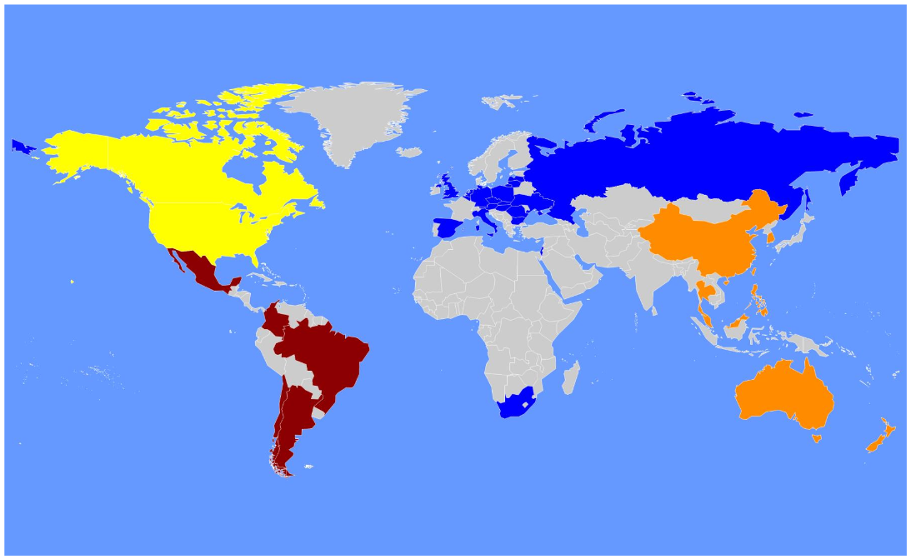
International enrolment
North America
n=3708 (25%)
190 sites
Europe
n=6788 (46%)
329 sites
Latin America
n=2727 (18%)
64 sites
Asia Pacific
n=1529 (10%)
104 sites
Total Randomised = 14752
Mentz RJ, et al. Am Heart J, 2017; 187: 1-9

Slide 6
Baseline characteristics
Characteristic | Exenatide n=7356 | Placebo n=7396
Age (years) | 62.0 (56.0, 68.0) | 62.0 (56.0, 68.0)
Female | 2794 (38.0) | 2809 (38.0)
White | 5554 (75.5) | 5621 (76.0)
Body Mass Index (kg/m²) | 31.8 (28.2, 36.2) | 31.7 (28.2, 36.1)
eGFR (mL/min/1.73 m²)* | 76.6 (61.3, 92.0) | 76.0 (61.0, 92.0)
Duration of diabetes (years) | 12.0 (7.0, 17.0) | 12.0 (7.0, 18.0)
HbA_{1c} (%) | 8.0 (7.3, 8.9) | 8.0 (7.3, 8.9)
History of congestive heart failure | 1161 (15.8%) | 1228 (16.6%)
Values are median (IQR) for continuous variables or n / N (%) for categorical variables. Percentages presented are for available data.
*MDRD formula used to calculate eGFR. Site-reported values are presented.

Slide 7
Participant follow-up and study medication duration
 | Exenatide n=7356 | Placebo n=7396
Study Duration Median (IQR), years | 3.3 (2.3, 4.4) | 3.2 (2.2, 4.3)
Premature Study Medication Discontinuation* | 43% | 45%
Study Medication Duration Median (IQR), years | 2.4 (1.4, 3.8) | 2.3 (1.2, 3.6)
Proportion of Time on Study Medication Mean (SD) | 76 ± 35% | 75 ± 35%
* Site-reported premature permanent discontinuation of study medication

Slide 8
Average differences in CV risk factors during follow-up
 | LS Mean Difference (95% CI) | p-value
HbA_{1c} (%) | -0.53 (-0.57, -0.50) | <0.001
Weight (kg) | -1.27 (-1.40, -1.13) | <0.001
Systolic Blood Pressure (mmHg) | -1.57 (-1.92, -1.21) | <0.001
Diastolic Blood Pressure (mmHg) | +0.25 (0.04, 0.47) | 0.020
Heart Rate (bpm) | +2.51 (2.28, 2.74) | <0.001

Slide 9
No differences in prespecified safety outcomes
  SAEs & treatment emergent SAEs
  Severe hypoglycaemia
  Pancreatitis
  Charter defined malignancy
      Specifically, no differences in pancreatic or medullary thyroid cancer

Slide 10
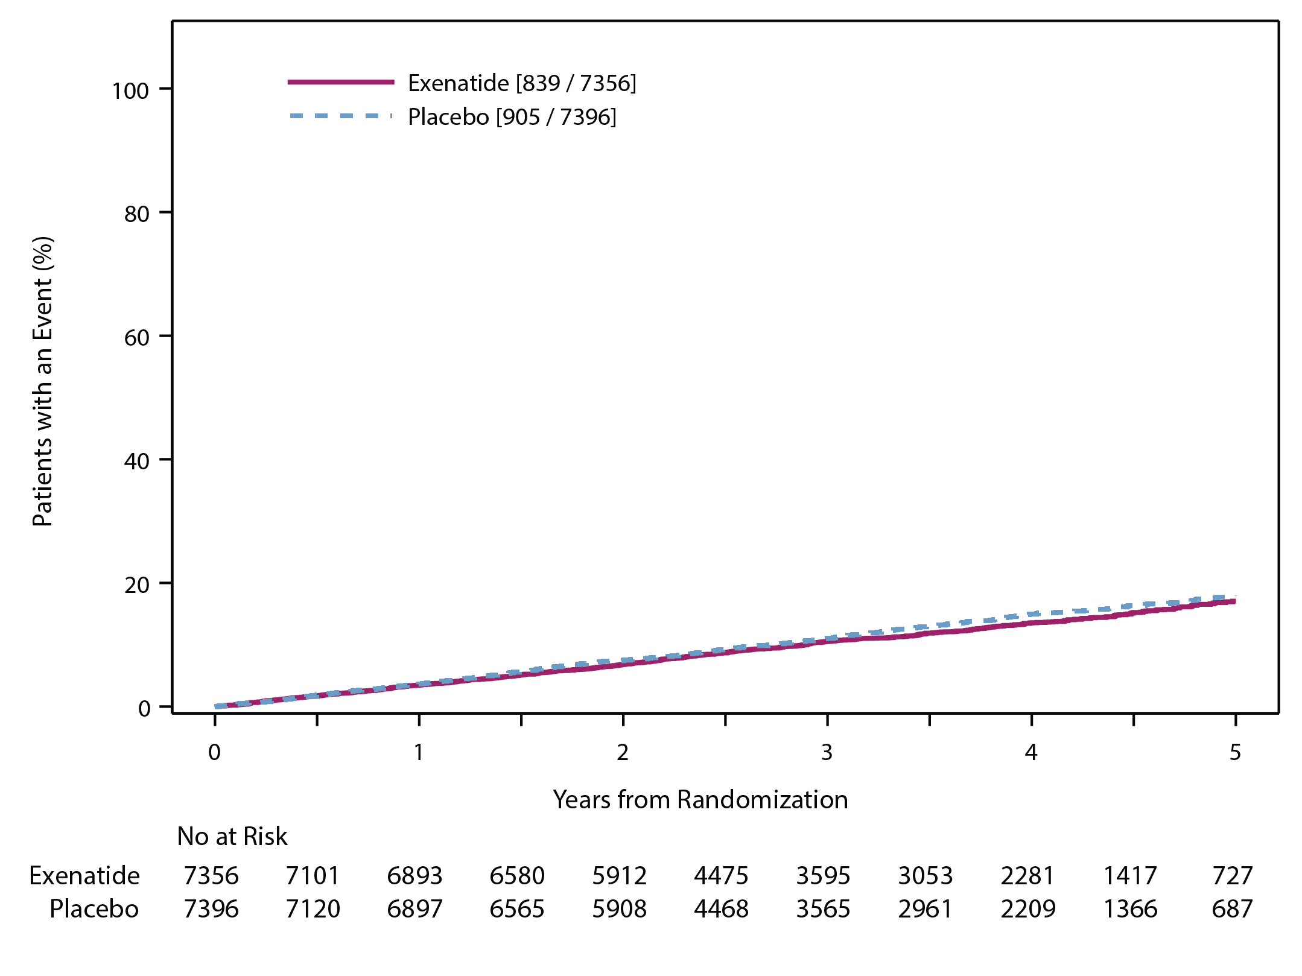
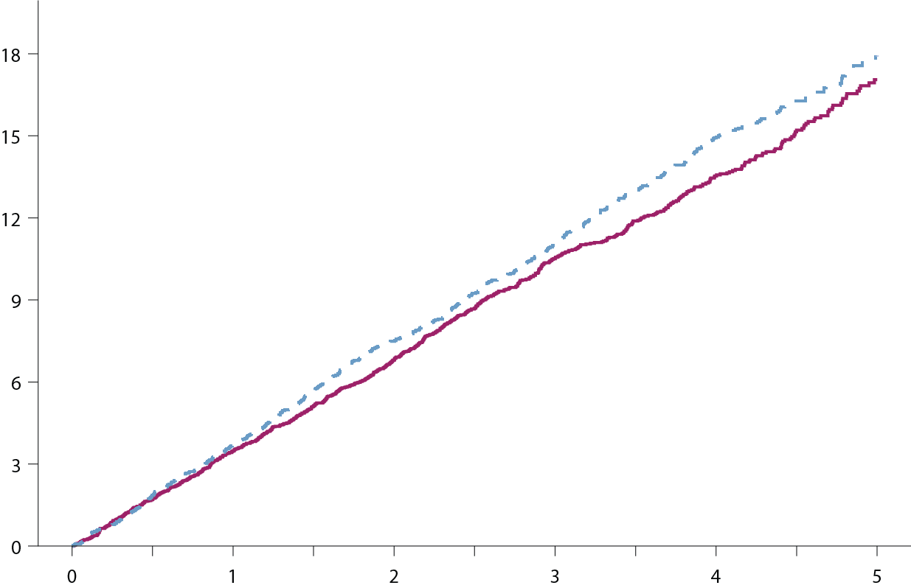
Primary composite: MACE-3 (CV death, nonfatal MI, nonfatal stroke)
Intention-to-Treat Analysis for Non-inferiority & Superiority
HR (95% CI) 0.91 (0.83, 1.00)
P value (non-inferiority) <.001
P value (superiority) 0.061

Slide 11
Primary composite cardiovascular outcome components
Exenatide
N=7356
Placebo
N=7396
Hazard Ratio
95% CI
P value
<.001
(non-inferiority)
0.061
(superiority)
839 (11.4%)
3.7 per 100 pt-yrs
905 (12.2%)
4.0 per 100 pt-yrs
MACE
0.91
0.83, 1.00
CV-death
229
(3.1%)
258
(3.5%)
0.88
0.73, 1.05
0.628 (homogeneity among components)
Non-fatal MI
455
(6.2%)
470
(6.4%)
0.95
0.84, 1.09
Non-fatal stroke
155
(2.1%)
177
(2.4%)
0.86
0.70, 1.07
Exenatide
favoured
Placebo
favoured

Slide 12
Secondary endpoints
Exenatide
N=7356
Placebo
N=7396
Hazard Ratio
95% CI
P value
All-cause mortality
507
(6.9%)
584
(7.9%)
0.86
0.77, 0.97
0.016
CV-death
340
(4.6%)
383
(5.2%)
0.88
0.76, 1.02
0.096
Fatal or non-fatal MI
483
(6.6%)
493
(6.7%)
0.97
0.85, 1.10
0.622
Fatal or non-fatal stroke
187
(2.5%)
218
(2.9%)
0.85
0.70, 1.03
0.095
Hospitalisation for ACS
602
(8.2%)
570
(7.7%)
1.05
0.94, 1.18
0.402
Hospitalisation for heart failure
219
(3.0%)
231
(3.1%)
0.94
0.78, 1.13
0.485
Exenatide
favoured
Placebo
favoured

Slide 13
Putting EXSCEL in context

Slide 14



Completed GLP-1 Receptor Agonist Cardiovascular Outcome Trials
Key inclusion criteria
A_{1C} , %
Median follow-up duration (y)
Drug exposure time (y)
Primary End point
(1)
5.5-11.0
Lixisenatide
1.9
MACE-4
(non-inferiority)
ACS within 180 days
≥30y
R
2.1
N=6068
Placebo
2.0
≥50y with CVD/renal dysfunction/HF, or
≥60y with CV RFs
≥7.0
Liraglutide
3.5
MACE-3
(non-inferiority)
(2)
≥7.0
3.8
R
N=9340
Placebo
3.5
(3)
≥7.0
Semaglutide
1.8
MACE-3
(non-inferiority)
SUSTAIN-6
≥50y with CVD, or ≥60y with subclinical CVD
≥7.0
2.1
R
1.9
N=3297
Placebo
Established CVD as well as primary prevention (70/30 split), ≥18y
6.5-10.0
Exenatide
2.4
MACE-3
(non-inferiority for safety/
superiority for efficacy)
R
3.2
Placebo
2.3
N=14752
0
1
2
3
4
¹ Pfeffer MA et al. N Engl J Med 2015; 373: 2247–2257
² Marso SP et al. N Engl J Med 2016; 375: 311–322
³ Marso SP et al. N Engl J Med 2016; 375: 1834–1844
  Median Follow-up Duration (years)

Slide 15
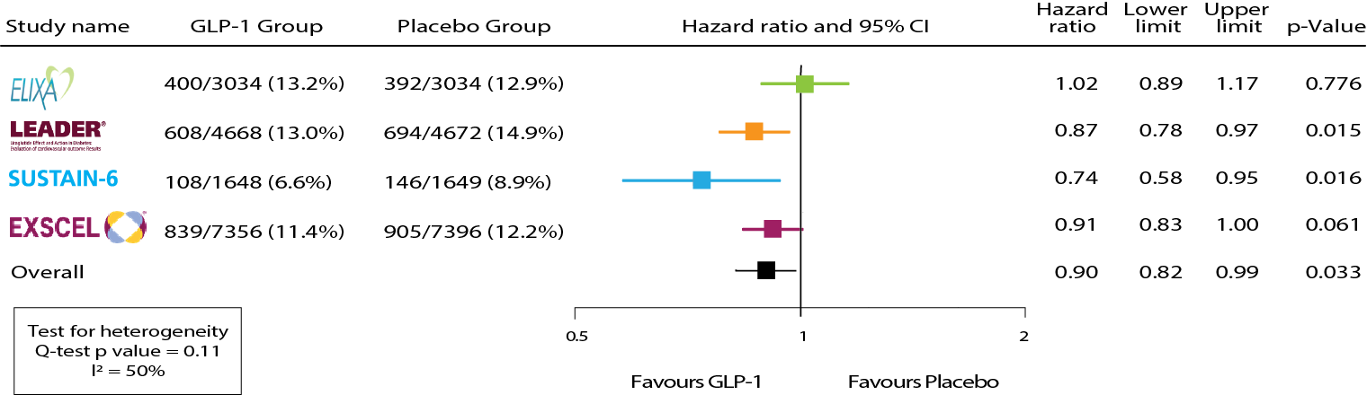
Meta-analysis: MACE-3 endpoint
Bethel et al. TLDE 2017; in press

Slide 16
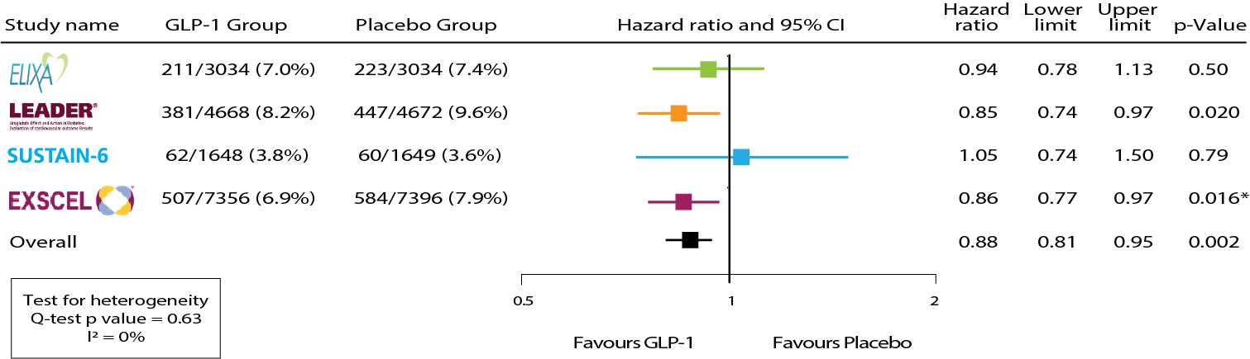
Meta-analysis: All-cause mortality
Bethel et al. TLDE 2017; in press

Slide 17
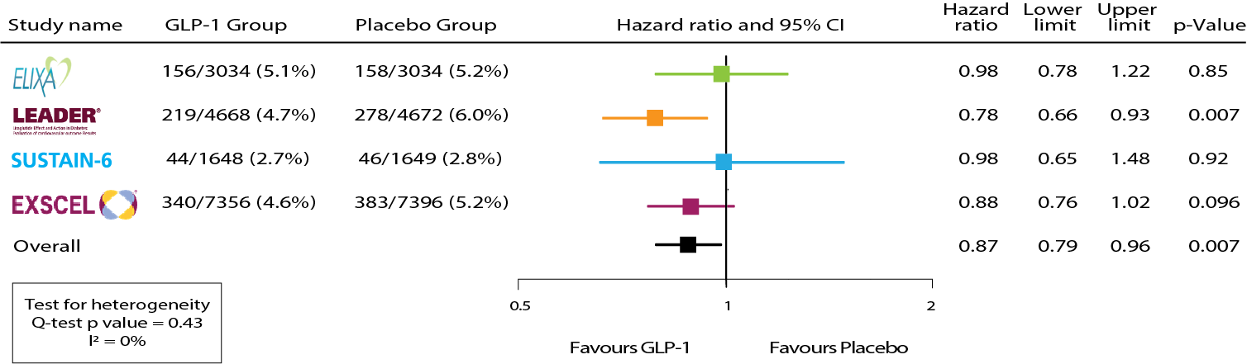
Meta-analysis: CV mortality
Bethel et al. TLDE 2017; in press

Slide 18
Meta-analysis: Other CV outcomes
Neutral impact of GLP-1 RA treatment
Endpoint | HR (95% CI) | p-value
Fatal and nonfatal myocardial infarction | 0.94 (0.86, 1.03) | 0.18
Fatal and nonfatal stroke | 0.87 (0.75, 1.00) | 0.052
Heart failure hospitalization | 0.93 (0.83, 1.04) | 0.20
Unstable angina hospitalization | 1.09 (0.90, 1.32) | 0.39

Slide 19
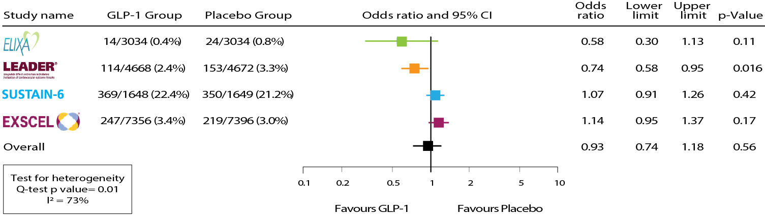
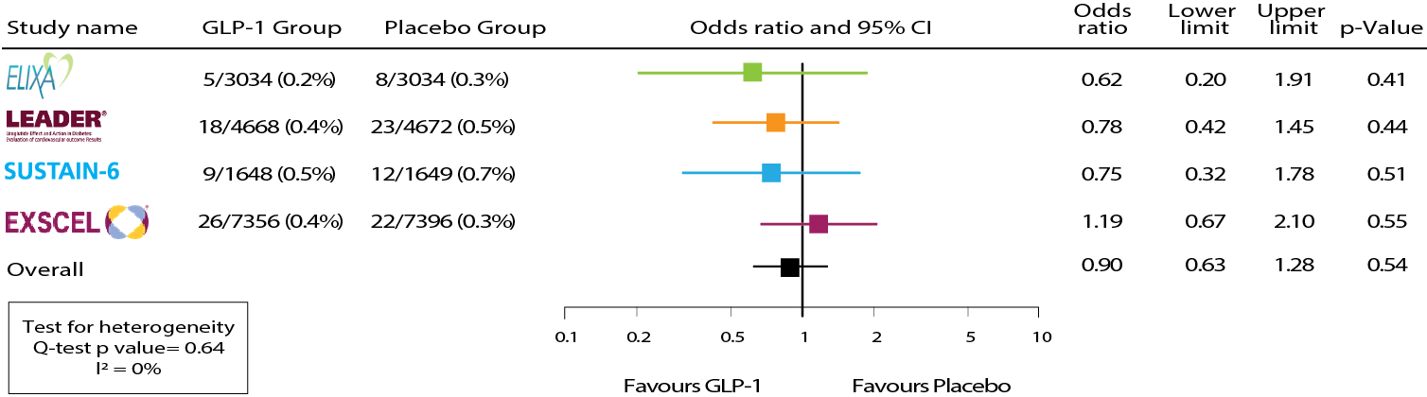
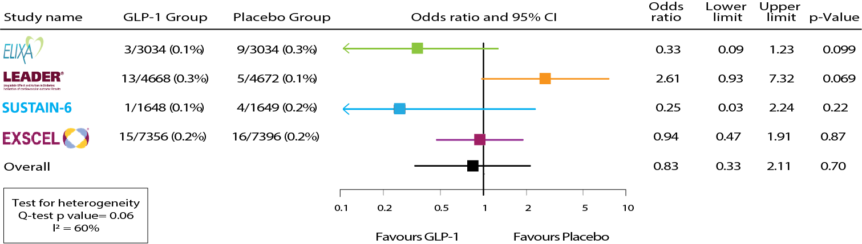
Meta-analysis: Safety Endpoints
Severe Hypoglycaemia
OR 0.93 (95% CI 0.74, 1.18), p=0.56
Pancreatitis
OR 0.90 (95% CI 0.63, 1.28), p=0.54
Pancreatic Cancer
OR 0.83 (95% CI 0.33, 2.11), p=0.70
Bethel et al. TLDE 2017; in press

Slide 20
Summary: main trial results
EXSCEL met its primary safety hypothesis
  MACE-3 HR 0.91 (0.83, 1.00), p<0.001 for non-inferiority
EXSCEL did not meet its primary efficacy hypothesis
  MACE-3 HR 0.91 (0.83, 1.00), p=0.061 for superiority
Secondary outcomes were consistent with the primary outcome
  All-Cause Mortality: HR 0.86 (95% CI 0.77, 0.97), p=0.016
Cardiovascular Death: HR 0.88 (95% CI 0.76, 1.02), p=0.096
Hospitalisation for Heart Failure: HR 0.94 (95% CI 0.78, 1.13), p=0.485
No imbalance in key safety endpoints
Severe hypoglycemia, pancreatitis, malignancy

Slide 21
Summary: GLP-1 RA class effects
Overall, the EXSCEL cardiovascular and mortality findings were consistent with those seen with other GLP-1 receptor agonists in the ELIXA, LEADER and SUSTAIN 6 trials further, supporting the use of these agents for the treatment of type 2 diabetes
For the class, there were significant reductions in
  MACE-3
  CV mortality
  All cause mortality
No differences in
  Hypoglycaemia
  Pancreatitis
  Pancreatic cancer
A favourable risk-benefit balance

Slide 22
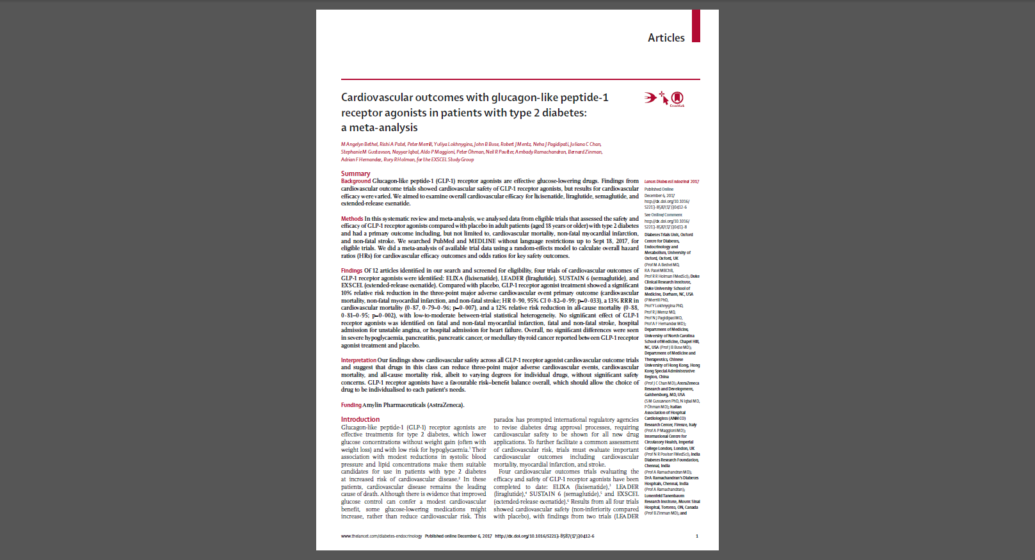

Available online at the close of this presentation:
DOI: 10.1016/S2213-8587(17)30412.6

