Slide 1
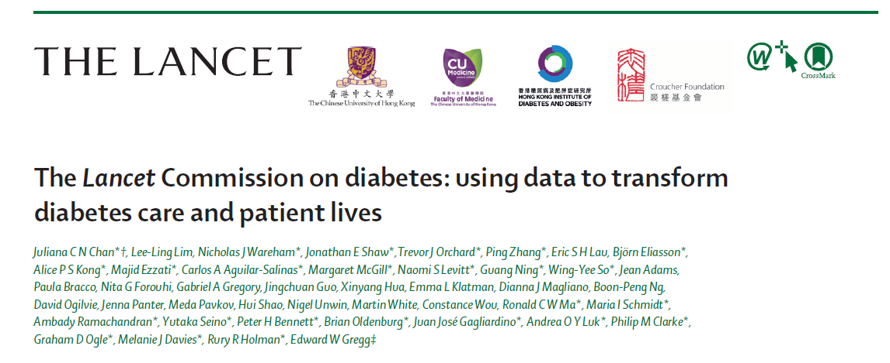
The Lancet Commission on Diabetes launched on 14/11/2020 World Diabetes Day
www.thelancet.com/commissions/diabetes

Slide 2
A 4-year project by 44 global experts and researchers in epidemiology, public health, clinical care and health economics from 5 continents to propose action plans to reduce burden of diabetes and NCD
26 members of Lancet Commission on Diabetes
http://www.hkido.cuhk.edu.hk/Research/The-Lancet-Clinical-Diabetes-Commission

Slide 3
Variation in Type 1 diabetes* related mortality gives important opportunities for improvement
*diagnosed before age of 40
https://www.thelancet.com/commissions/diabetes
Chan JC …. Gregg E. Lancet 2020

Slide 4
Cumulative incidence of diabetes-related complications and death from childhood onset type 1 diabetes shows no improvement, by calendar year of diabetes onset, at any disease duration*
*Data from Pittsburgh Epidemiology of Diabetes Complications study
https://www.thelancet.com/commissions/diabetes
Chan JC …. Gregg E. Lancet 2020

Slide 5
Modelling in Type 1 diabetes related deaths before the age of 25 Minimal versus intermediate care
Standardized mortality rate
2.5 for comprehensive care (mainly high income countries)
4.9 for intermediate care (upper-middle-income countries (MICs))
13.6 for 50% minimal and 50% intermediate care (lower MICs)
33·9 for 50% minimal and 50% intermediate care (low income countries)
2017
1.61 million people with T1D aged <25 years who were diagnosed before the age of 20
14 466 young individuals with T1D died
12 092 deaths (84%) prevented if all nations implemented guideline-based intermediate care
Basal bolus human insulin regimen
Tools for self-monitoring of blood glucose
Education for self management
Regular A1c monitoring and complication screening
https://www.thelancet.com/commissions/diabetes
Chan JC …. Gregg E. Lancet 2020
Notes:
We estimated in 2017 that there are 1.6 million people with type 1 diabetes and 14,000 people have died, compare to people without DM, people with T1D living in HIC receiving comprehensive care had SMR of 2, as compared to 4.9 in those receiving intermediate care living in UMICs and 13.6-33.6 in those receiving either minimal or intermediate care in LMICs. We estimated that by ensuring that people with T1D received intermediate care with b/b insulin, SMBG, education and Cx sreening, over 80% of these 14000 deaths could be prevented

Slide 6
Evidence-based strategies in Type 2 diabetes based on decades of research
Reducing HbA1c by 0.9%, systolic BP by 10 mmHg, LDL-C by 1 mmol/L, or a combination of all three, independently can reduce the risk of CVD, all-cause death, or both, by 10–20% in patients with T2D
Reducing multiple risk factors, including by use of statins and renin–angiotensin system (RAS) inhibitors, can prevent CV-renal events by 20–40% in individuals with or at risk of having diabetes
Use of SGLT2 inhibitors and GLP-1 receptor agonists can reduce CV–renal events and death rates by up to 40%, independent of their effect on lowering blood glucose concentration
Use of data-driven, team-based integrated care through care reorganisation can reduce CVD and all-cause death in patients with T2D by 20–60%
Sustained weight reduction in obese patients with T2D with less than 6 years of disease by 15 kg or more can induce remission of T2D for up to 2 years
Structured lifestyle intervention and use of metformin can each prevent or delay T2D in individuals with impaired glucose tolerance by 30–50%
https://www.thelancet.com/commissions/diabetes
Chan JC …. Gregg E. Lancet 2020

Slide 7
Glycemic control in 1.9 million people with type 1 and type 2 diabetes in cohorts with at least 5000 individuals
Type 1 diabetes
Type 2 diabetes
Age < 60 years
https://www.thelancet.com/commissions/diabetes
Chan JC …. Gregg E. Lancet 2020

Slide 8
Declining mortality rates in diabetes mean opportunities for changes
https://www.thelancet.com/commissions/diabetes
Adapted from Harding JL et al Diabetologia 2019
Chan JC …. Gregg E. Lancet 2020

Slide 9
Meta-analysis: Impacts of reducing BP, LDL-C & A1c
*Defined as cardiovascular death, non-fatal stroke, or non-fatal myocardial infarction.
**Defined as sudden cardiac death, myocardial infarction, revascularisation, fatal/non-fatal stroke, or fatal/non-fatal heart failure.
https://www.thelancet.com/commissions/diabetes
Chan JC …. Gregg E. Lancet 2020

Slide 10
Reducing BP and LDL-C can prevent millions of death in top 10 LMICs with highest disease burden
https://www.thelancet.com/commissions/diabetes
Chan JC …. Gregg E. Lancet 2020

Slide 11
Reduce disparity of medicine costs and improve access with continuing care and support to ensure adherence
https://www.thelancet.com/commissions/diabetes
Chan JC …. Gregg E. Lancet 2020

Slide 12
Emerging challenges: premature death and multiple morbidities due to young onset diabetes
Adapted from Ke C et al Annals Int Med 2019
https://www.thelancet.com/commissions/diabetes
Chan JC …. Gregg E. Lancet 2020

Slide 13
Task shifting to promote team-based care, self management and provider-patient communication independently reduce risk factors
Adapted from Lim LL et al Diabetes Care 2018
Chan JC ….E Gregg. Lancet 2020
https://www.thelancet.com/commissions/diabetes

Slide 14
Diabetes centers, teams, plans and registers integrating care delivery, education (patient/professional) and data collection
Data set for Diabetes Register
Multifunctional nature of Specialized Diabetes Centre
https://www.thelancet.com/commissions/diabetes
Chan JC …. Gregg E. Lancet 2020

Slide 15
A blueprint for the setup, workforce, processes for a diabetes team to deliver care and prevention program
https://www.thelancet.com/commissions/diabetes
Chan JC …. Gregg E. Lancet 2020

Slide 16
Actions versus no action saves millions of lives
50% diagnosis rate, 70% treatment rate for 3 years in people with diabetes in China
https://www.thelancet.com/commissions/diabetes
Chan JC …. Gregg E. Lancet 2020

Slide 17
Actions versus no action saves billions of dollars
50% diagnosis rate, 70% treatment rate for 3 years in people with diabetes in China
https://www.thelancet.com/commissions/diabetes
Chan JC …. Gregg E. Lancet 2020

Slide 18
A public and personal health challenge calls for a societal-community-individualized strategy
https://www.thelancet.com/commissions/diabetes
Chan JC …. Gregg E. Lancet 2020

Slide 19
Society-community-individualized and life-course interventions in line with recommendations by the United Nations, WHO and professional bodies
Adapted from Ma R et al PLoS Med 2017
https://www.thelancet.com/commissions/diabetes
Chan JC …. Gregg E. Lancet 2020

Slide 20
Evidence-based practice and practice-based evidence
Adapted from Ogilvie D et al J Epidemiol Community Health 2020
https://www.thelancet.com/commissions/diabetes
Chan JC ….E Gregg. Lancet 2020

Slide 21
Integrating population-based strategy with strengthening of healthcare systems for early detection and intervention
https://www.thelancet.com/commissions/diabetes
Chan JC ….Gregg E. Lancet 2020

Slide 22
Modelling potential Impacts of an integrated societal-population-community strategy to promote public health, early detection and intervention
If all components are successfully implemented in an integrated manner, for every 1 million adults
After 10 years
22 489 diabetes events
17 270 cardiovascular events
After 20 years,
33 733 diabetes events
51 863 cardiovascular events
For 1.3 billion people in China
prevention of T2D in 44 million adults
Prevention of CVD in 67 million adults
To get the simulation model, please email
paz2@cdc.gov at US-CDC
https://www.thelancet.com/commissions/diabetes
Chan JC …. Gregg E. Lancet 2020

Slide 23
Linking clinical to population data to inform policies and practices
Adapted from IDF Atlas 2019
https://www.thelancet.com/commissions/diabetes
Chan JC …. Gregg E. Lancet 2020

Slide 24
Declining incidence of diabetes in countries/areas Improve policies, systems, education and data collection
Key messages and recommendations
Ensure access to insulin, education, SMBG tools in T1D and underserved communities
A multicomponent life-course strategy to prevent maternal hyperglycaemia, childhood obesity and young-onset diabetes may benefit the next generation
Complex causes, notably psychosocial needs, especially in patients with young-onset diabetes, call for structured assessment to personalise care
Environmental, behavioural, and socioeconomic causes of T2D require a multi-tiered societal and population-based prevention strategy
Variations in diabetes diagnosis, treatment, and outcomes in different countries/regions are likely to be due to variations in investment, capacity, health-care systems, and care organisation
Sustained reduction of risk factors, smoking cessation and use of statins, RASi, SGLT2i inhibitors, and GLP-1 RA can reduce CV-renal diseases and all-cause death in patients with T2D
Team-based care enables systematic data collection during clinical practice to improve the quality of EMR for surveillance, prevention, and treatment
Strengthen existing infrastructures to provide continuing integrated care and create career paths for skilled physicians to reorganise diabetes care, train non-physician personnel, and use technology effectively to improve the accessibility, sustainability, and affordability of diabetes prevention and care
Adapted from Magliano D et al BMJ 2019
https://www.thelancet.com/commissions/diabetes
Chan JC ….. Gregg E. Lancet 2020

Slide 25
Close the gaps in care and prevention by closing the gaps in professional knowledge and data
Watch the Lancet Webinar
https://youtu.be/ybBiItOHeZE http://www.hkido.cuhk.edu.hk/

